Slide 1
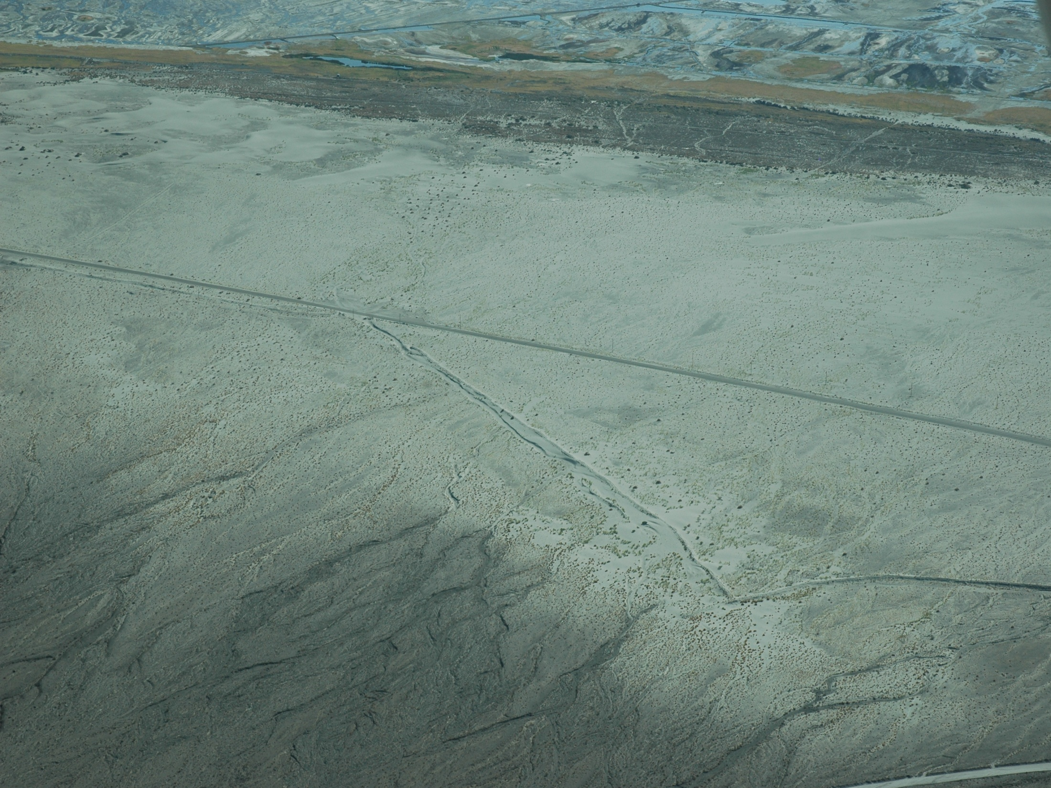

Workshop on the
Origin and Development of the
Keeler Dunes
Part 2: Technical Presentation
Great Basin Unified Air Pollution Control District
Governing Board Meeting
March 7, 2013
Oblique aerial photo with view to south across Keeler Dunes – Sept 2008

Slide 2
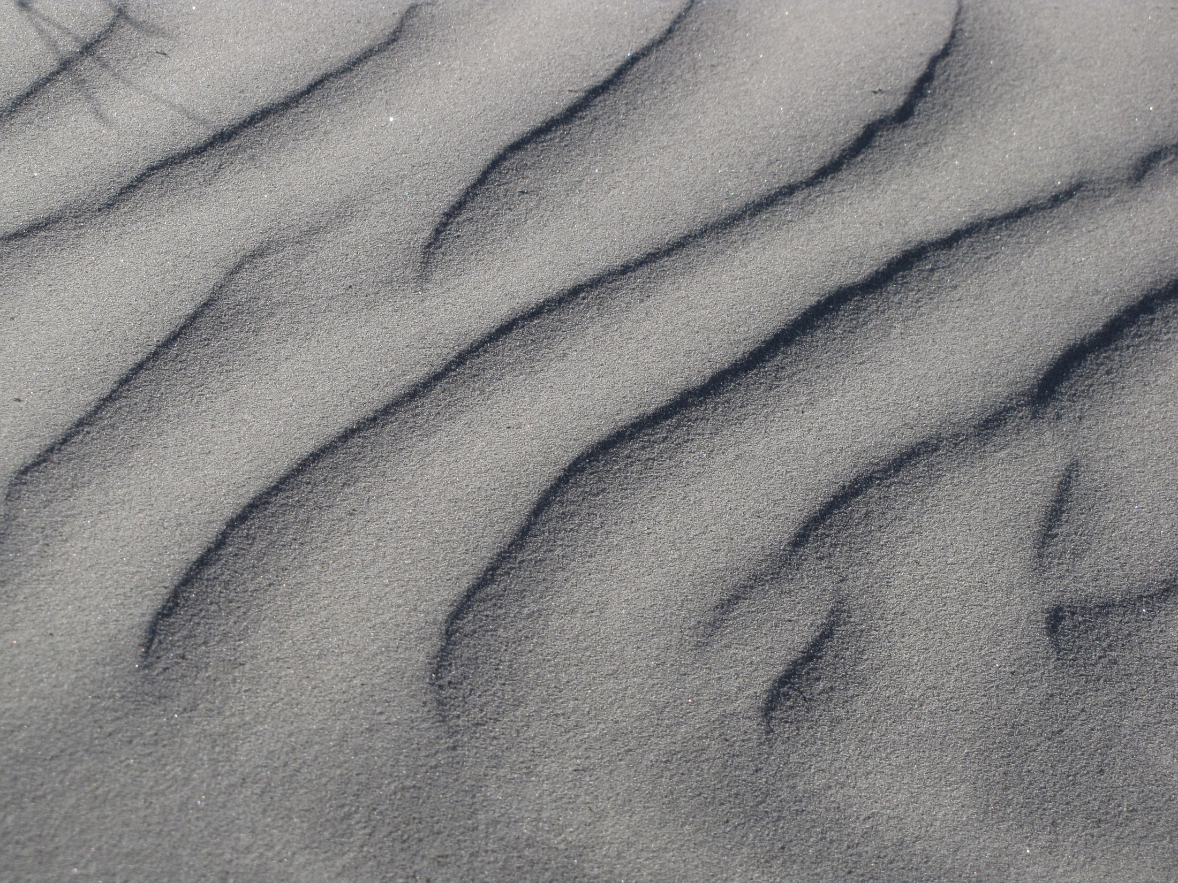
Project Components
Origin and Development of the Keeler Dunes
1. Historical Documents Research
4. Geomorphic Mapping and Analysis
3. Air Photo and Satellite Image Analysis
2. Historical Photos Analysis
5. Geology – Chronology and Stratigraphy
7. Dune Transect Analysis
6. Surface Change Analysis
Sand Source Analysis
Close-up of ripples on dune surface
Notes:
District conducted extensive research over a several year period on the origin of the Keeler Dunes and the landscape development over time.
the research can be divided into 7 main categories ranging from:
search and analysis of historical documents, maps and photos to
geologic and geomorphic investigations (including detailed mapping, age dating of sand deposits, and mineralogical analyses) to
analysis and modeling of sand movement in the area
investigations also included an analysis of where the sand in the dunes came from (sand source analysis)
The Results of each component is written up in the Final Staff Report and associated Technical Reports

Slide 3
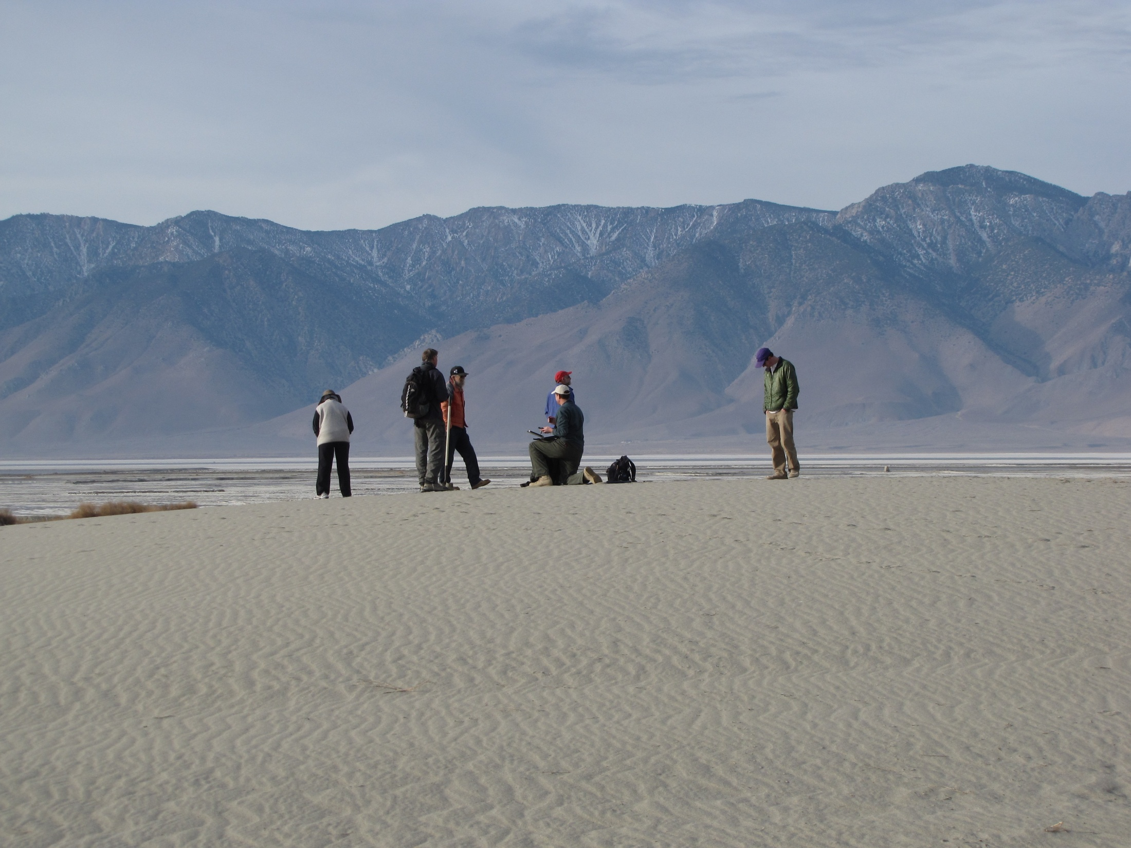
Technical Project Team
District Staff
  Dr. Grace Holder
  Mr. Duane Ono
  Ms. Sondra Grimm
  Mr. Phill Kiddoo
  Mr. Chris Howard
  Mr. Mike Slates
Scientific Experts
  Dr. Nicholas Lancaster (DRI)
  Mr. Steven Bacon (DRI)
  Dr. Jack Gillies (DRI)
  Dr. Scott Stine (Professor Emeritus)
  Dr. Tiffany Clark (Sapphos Environmental Inc)
  Ms. Donna Grotzinger (Sapphos Environmental Inc)
  Dr. David Groeneveld (HydroBio Inc)
(Dune on top of Old State Highway, December 2011)
Notes:
Introduce Project team and explain what investigations they works on
District Experts:
Sondra Grimm– historic photo analysis, main person in the field in the Keeler Dunes and is the most knowledgeable about the nature and condition of the dune area.
Duane Ono – Deputy APCO, conducted the analysis and modeling of sand motion monitoring data
Phill Kiddoo, Chris Howard, and Mike Slates – Data processing and data analysis
Outside Scientific Experts:
Sapphos Environmental – Tiffany Clark, Marie Campbell and Donna Grotzinger – historical document research, cultural resource issues
Scott Stine – geological and geomorphological research (Professor Emeritus at CSEB) has conducted research on Mono and Owens Lakes and other pluvial lakes in the GB for decades focusing on paleoclimate changes.
DRI:
Nick Lancaster – air photo and satellite image analysis and geology (Research Professor at DRI specializing in aeolian dune systems, author of books on dunes and numerous peer-reviewed scientific papers). Extensive work and experience in dune systems all over the world.
Steve Bacon – geomorphological research and geology (Associate Research Geomorphologist specializing in research of Quaternary geology and geomorphology. Steve has authored numerous scientific articles on the changes in lake levels of pluvial lakes in the Great Basin. Most of the information from the LADWP uses the results of Steve’s research)
Jack Gillies: Research Professor with extensive experience in aeolian processes focusing on fugitive dust emissions and anthropogenic processes. Extensive research in the desert SW and internationally in Canada, Africa, and Antarctica.

Slide 4
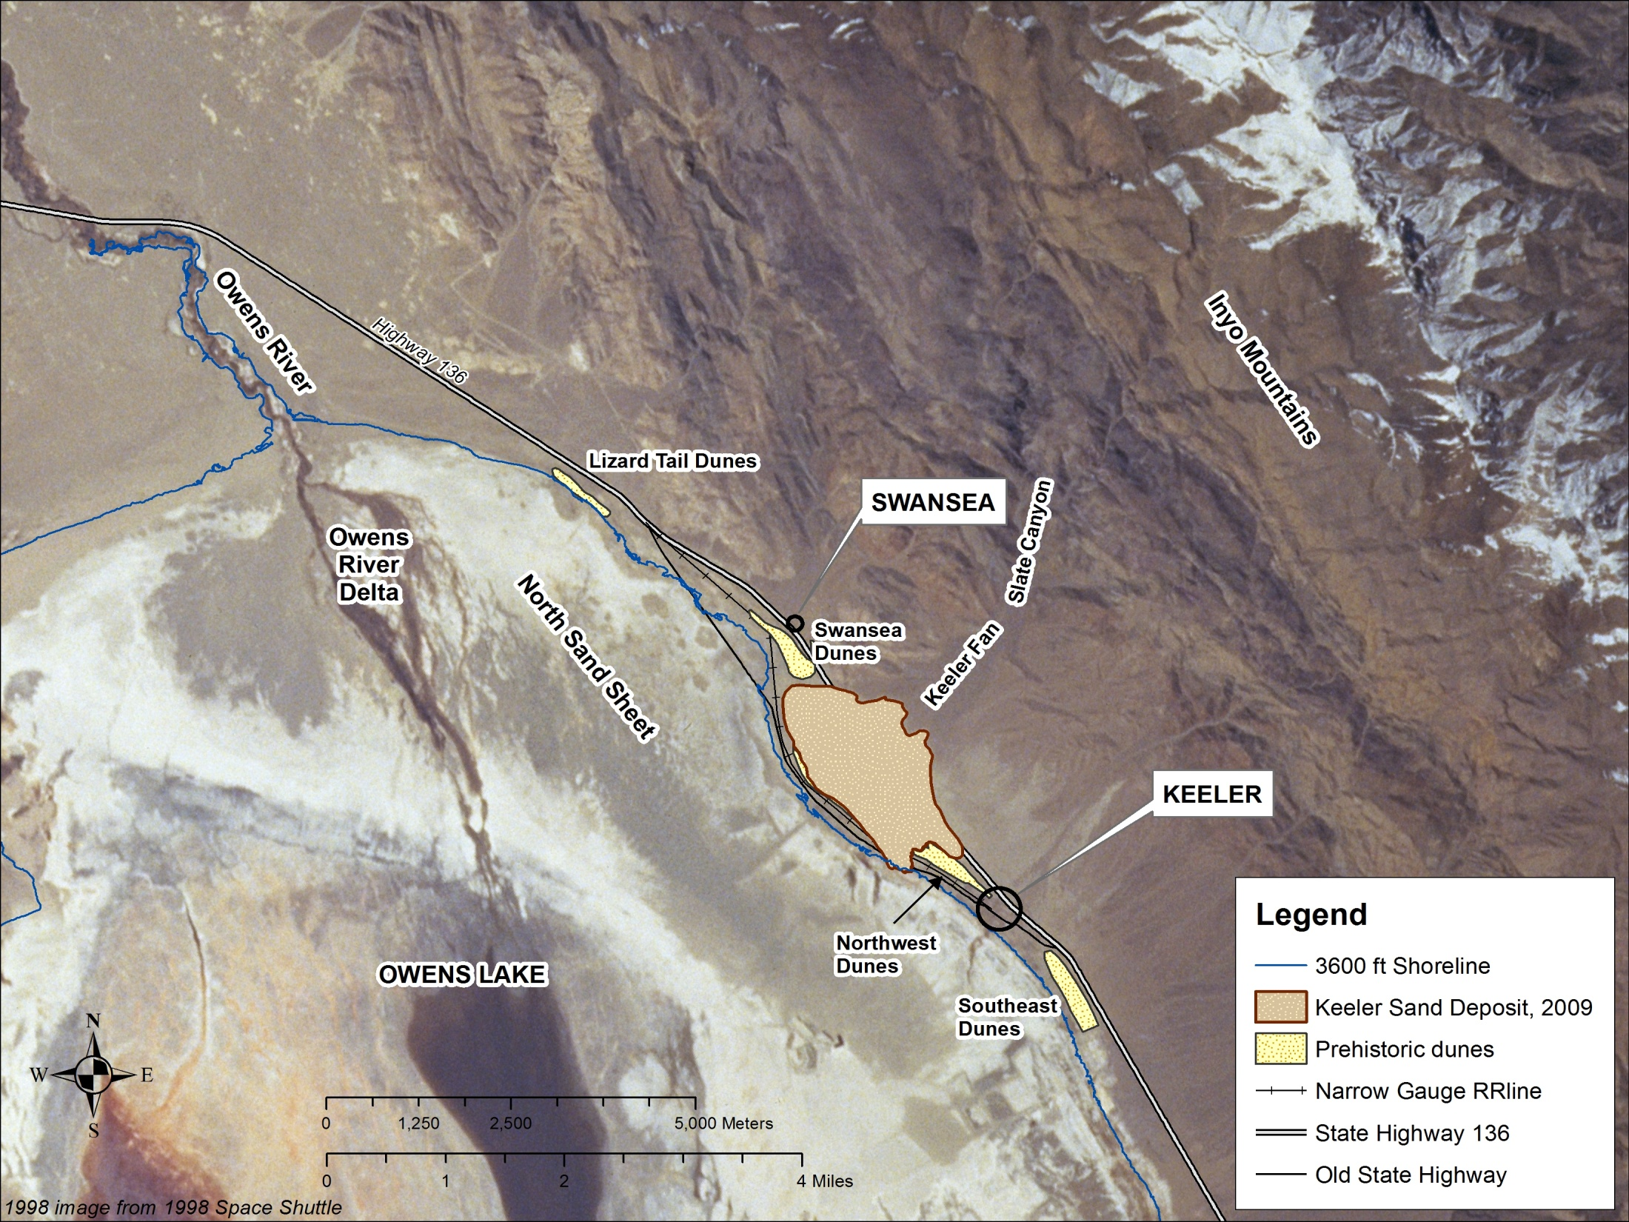
Geographic Locations
KEELER
DUNES
1998 Space Shuttle image background
Notes:
Provide orientation to locations and terms used in presentation
Communities – Keeler and Swansea
Dune areas – Keeler Dunes, Lizard tail dunes, Swansea Dunes, Northwest dunes, Southeast dunes
Owens Lake, Owens River delta, brine pool, North Sand Sheet
Highway 136, Old State Highway, Narrow gauge railway route

Slide 5
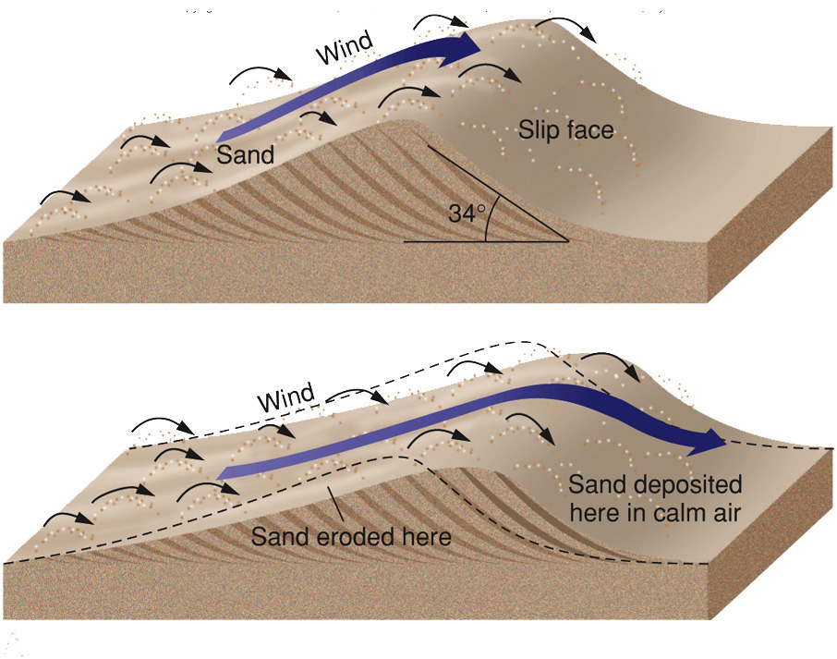
Dune Formation
(Unstable migrating dunes = modern active Keeler Dunes)
Sand moves by a combination
saltation (“bouncing” or “jumping”)
surface creep
Wind
Dune movement
Notes:
Short discussion on dune formation: separate dunes into two general categories – migrating active dunes & stable vegetated dunes
unstable active dunes are characterized by mobile sands that saltate and creep with prevailing high winds.
form distinct dune forms with movement – asymmetric form with steep slip face pointed in the direction that wind is moving. Internal structure has crossbeds that reflect the preservation of the slip face deposits. Windward side is less steep and generally has relatively flat lying sand layers.

Slide 6
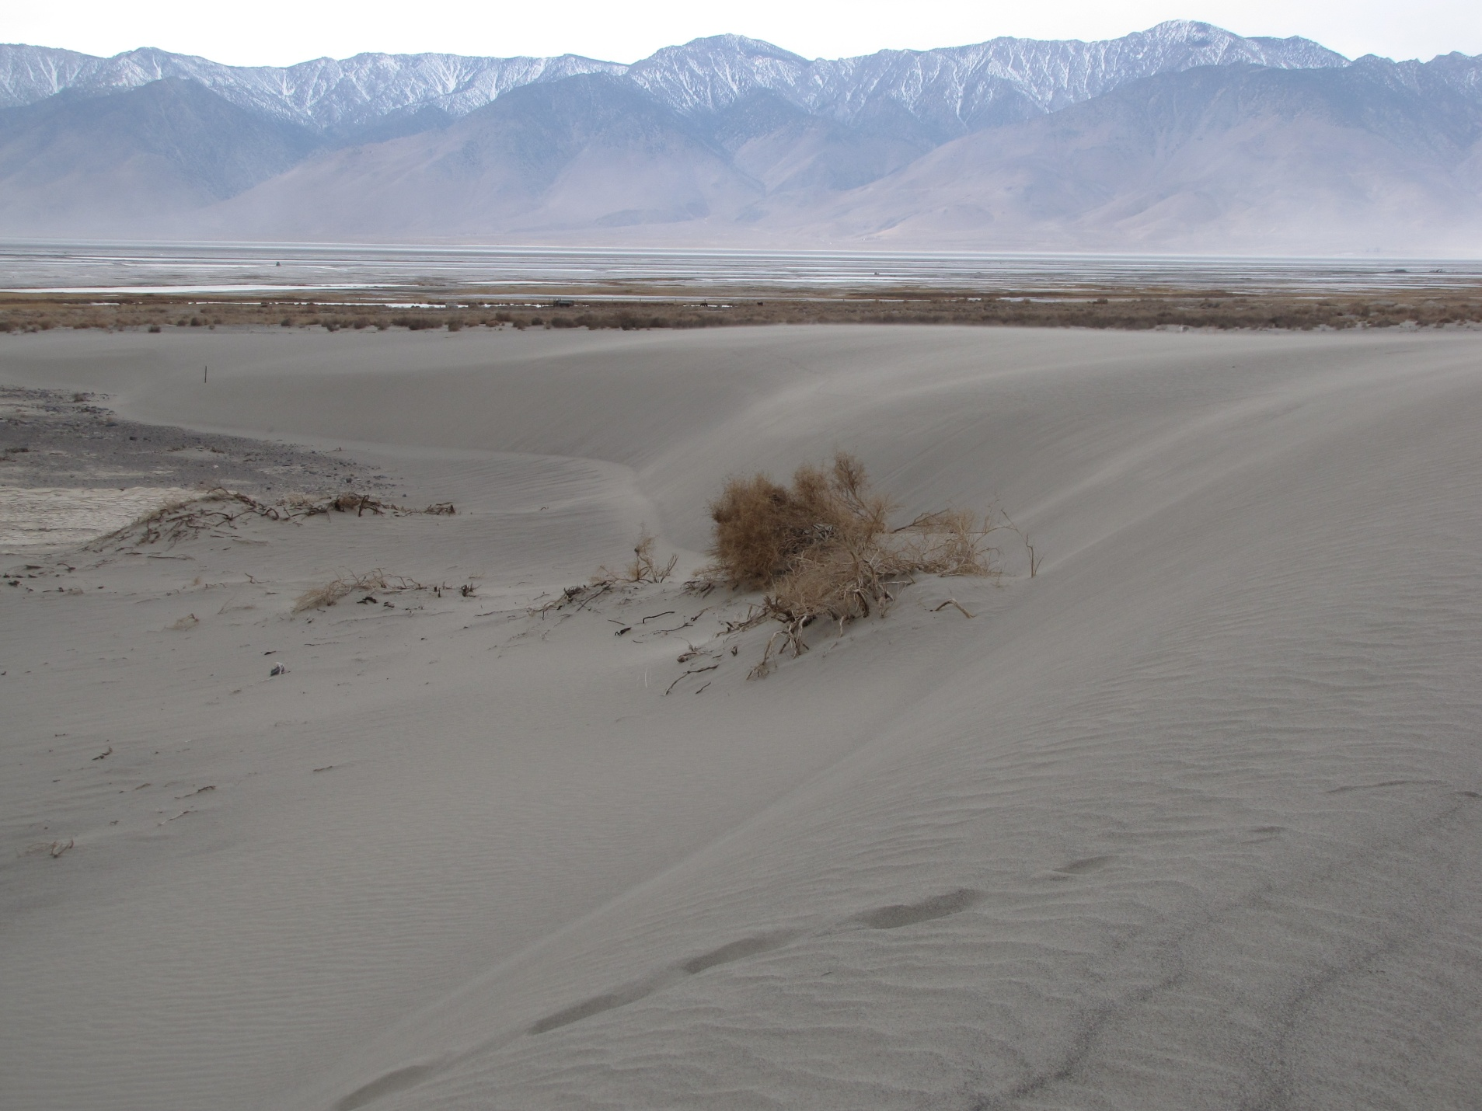
Active Migrating Dune
(Southern Keeler Dunes, January 2013)

Slide 7
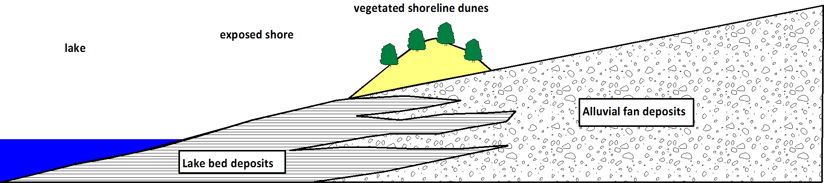
Vegetated Dunes
Stable Vegetated Dunes
sand movement
natural lake level drop
(graphic is for illustrative purposes only an is not drawn to scale)
Shoreline dune morphology
Form in linear bands parallel to shore
Form “in-balance” with sand supply such that they are stabilized with vegetation
Notes:
Lakeshore or Shoreline Dunes:
form by movement of material from exposed shore or a body of water. Along the coast – the material is supplied by the beach and replenished by waver action bringing new sand to the shore.
along a lake that does not have significant wave action – material for dunes may be supplied during periods when the water level drops exposing more of the shore area sediments.
shoreline dunes tend to form in linear bands parallel to shoreline and since under natural conditions the sediment supply is limited, the dunes tend to be stabilized by vegetation.
shoreline dune deposits do not have the morphology of the “classic desert” dune.

Slide 8
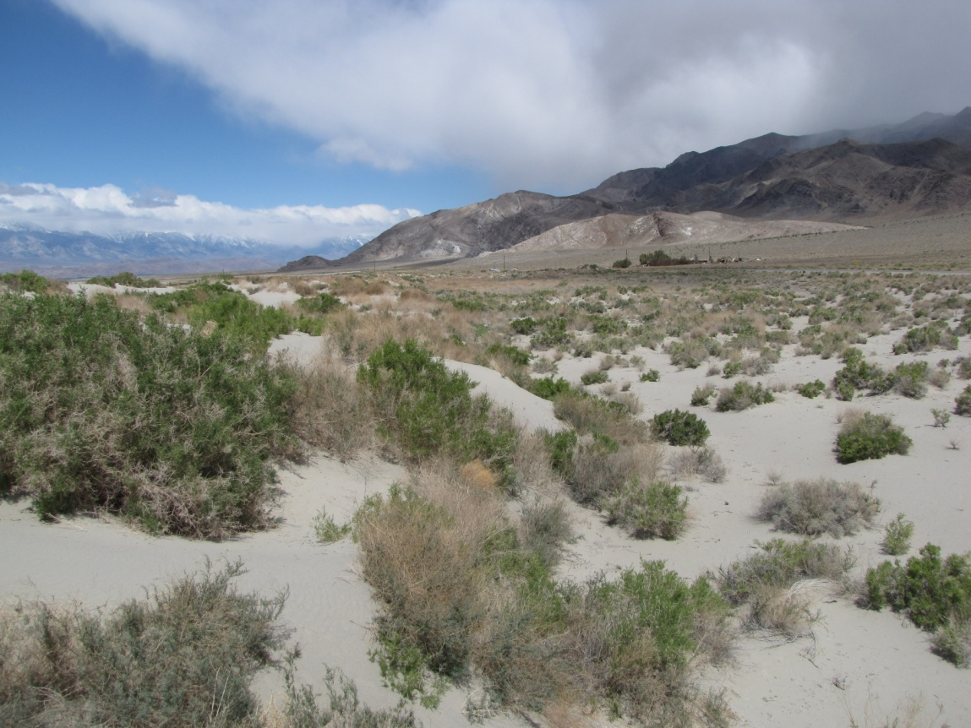
Vegetated Stable Dunes
(Swansea Dunes, April 2010)

Slide 9
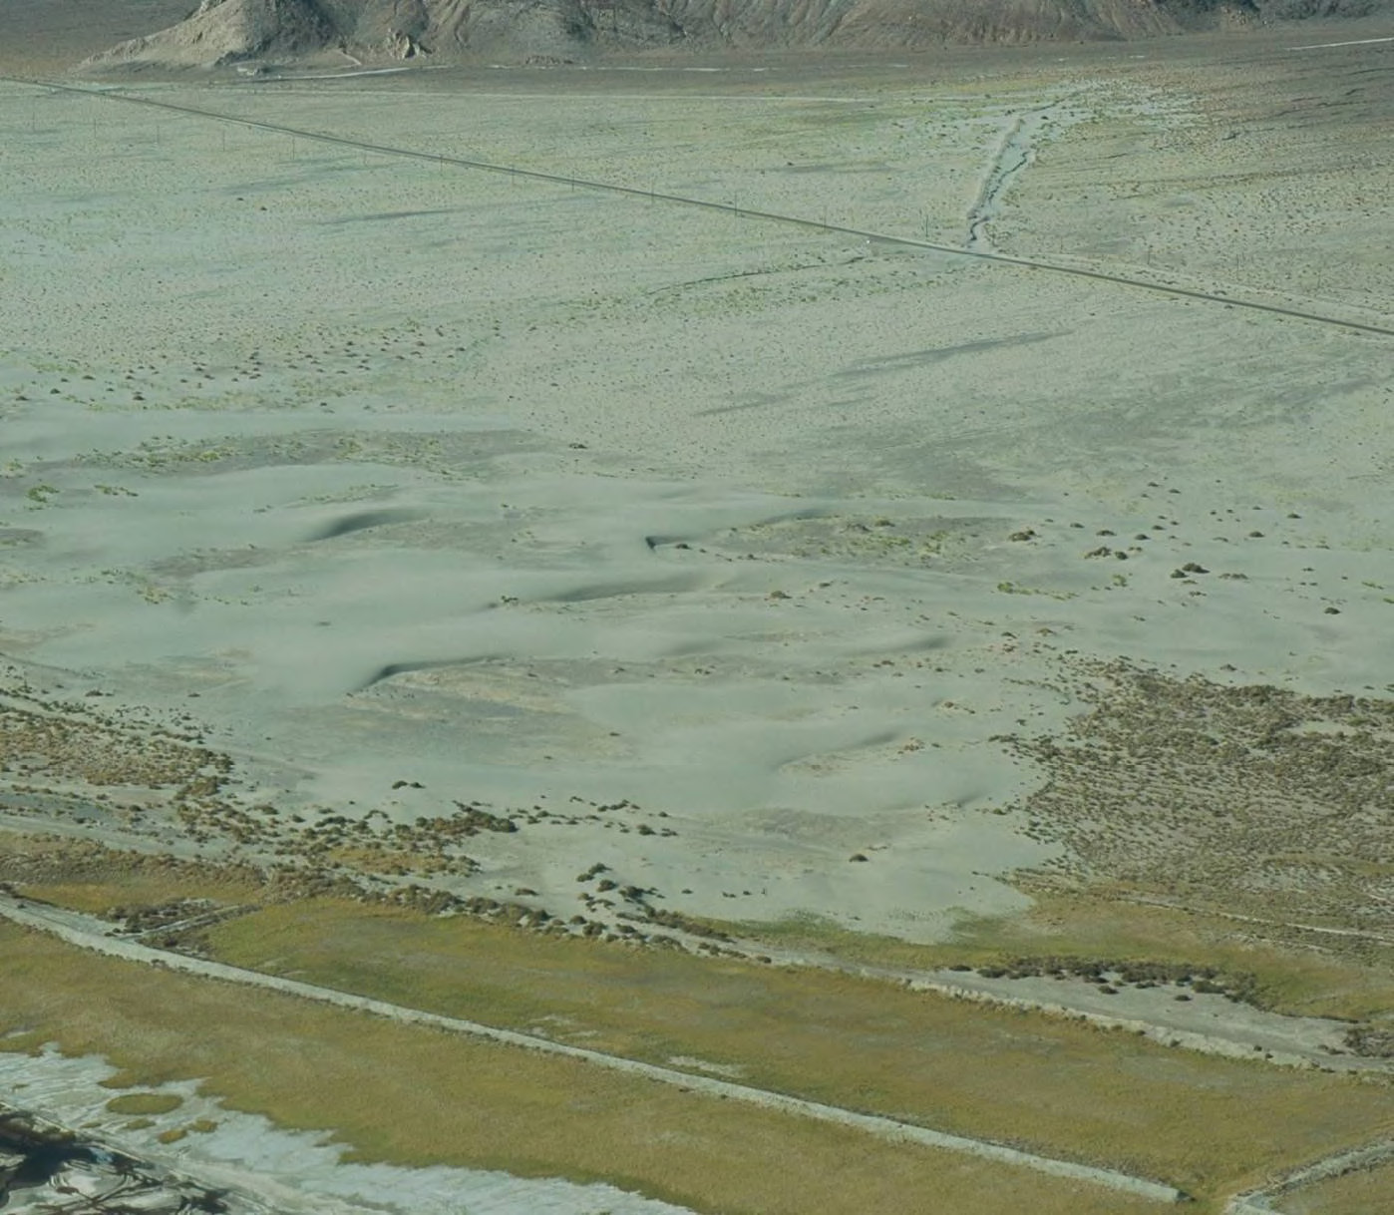
Landscape Periods
Pre-1860’s
1860 to 1920’s
1940’s to 1960
1960 to 2000
2000 to 2010
(oblique aerial photo over the southern Keeler Dunes by HydroBio, 2010)
Notes:
Division of the timeframe of study for the Keeler Dunes into 5 periods:
Pre-1860’s = represents historic conditions prior to settlement of the Owens Valley by non-native people
1860’1920’ = time period during initial settlement of the OV and development of natural resources (agriculture, water diversions, minerals mining), desiccation of Owens Lake
(Time Gap late 1920’s to 1944)
1940’s to 1960’s = beginning of establishment of modern Keeler Dunes deposit
1960 to 2000 = expansion and migration of Keeler Dunes deposit
2000 to 2010 = dust control implementation on Owens Lake begin, erosion of W and NW portion of modern Keeler Dunes, continued migration of southern dunes to SE.

Slide 10
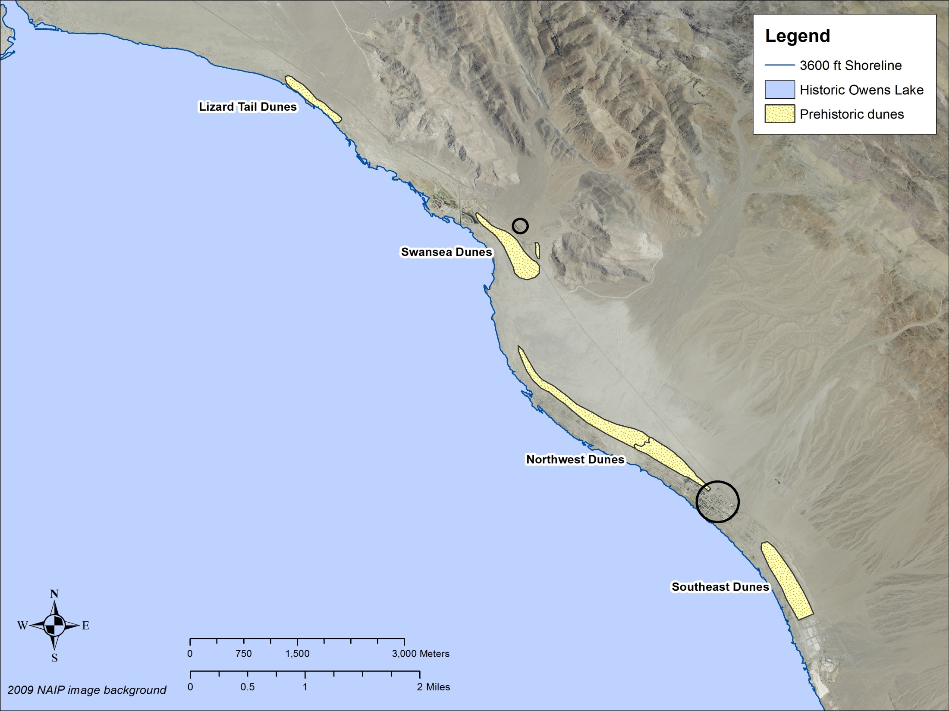
1. Pre-1860’s
Historic Owens Lake
and Dune Areas
Swansea
Owens Lake
Keeler
Notes:
Discussion points:
Von Schmidt public land survey in 1856, mapping of meanderline and classification of lands along section lines
Historic lake shore was also surveyed by Lee in 1913 by looking at the geomorphic features present
Four main Pre-historic dune areas preserved along eastern shorelands of Owens Lake.
Preserved pre-historic dunes have been age dated at ~300 to ~1700 years Before Present (BP)

Slide 11
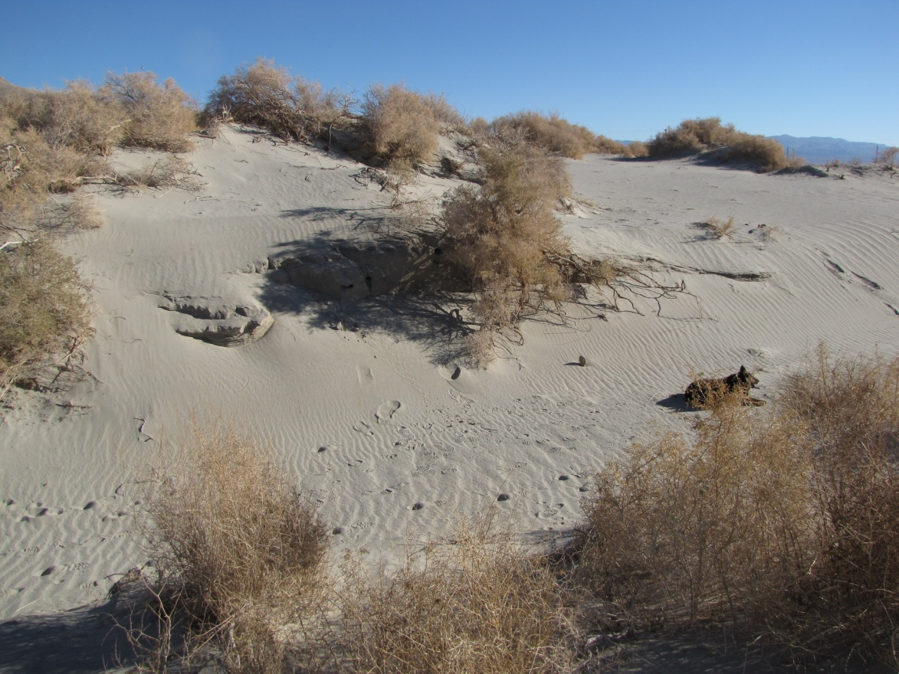
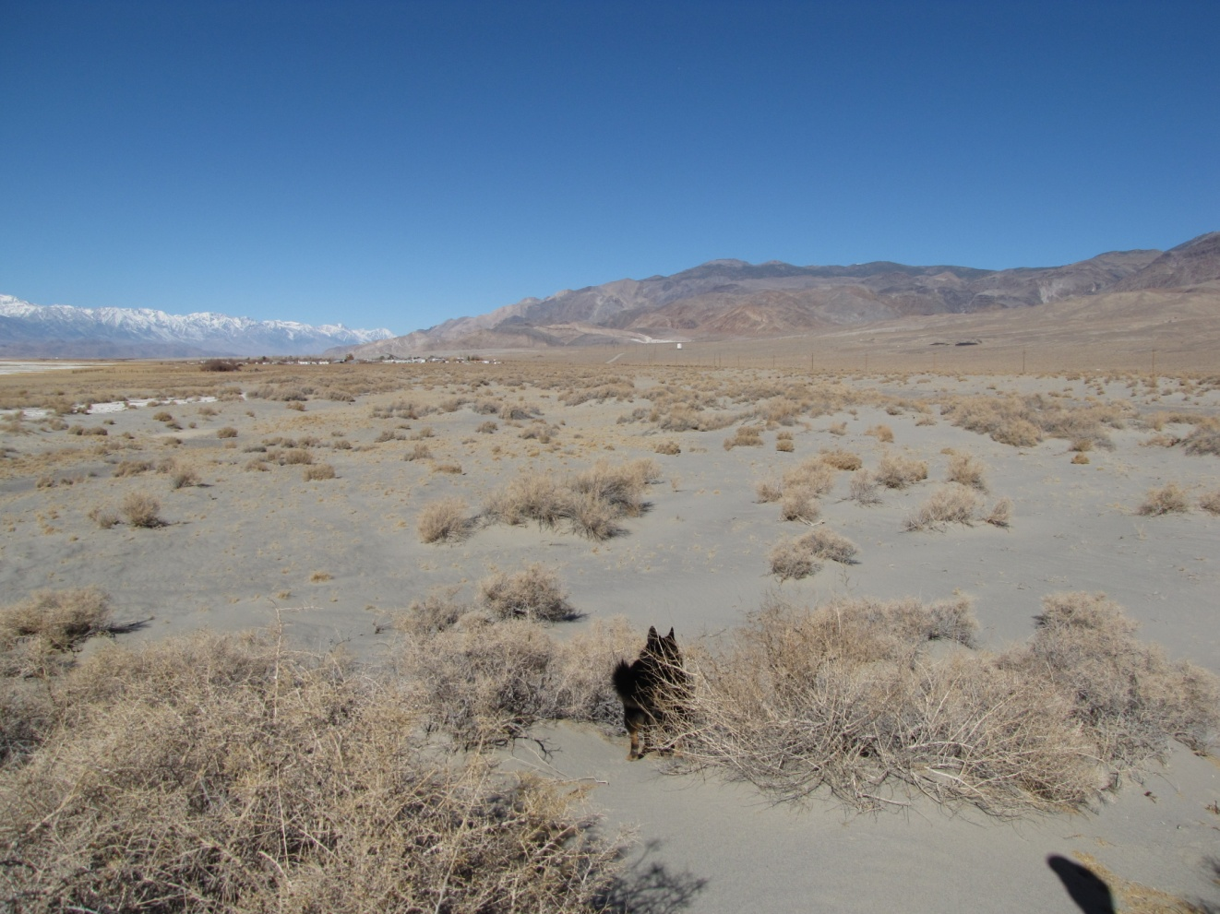
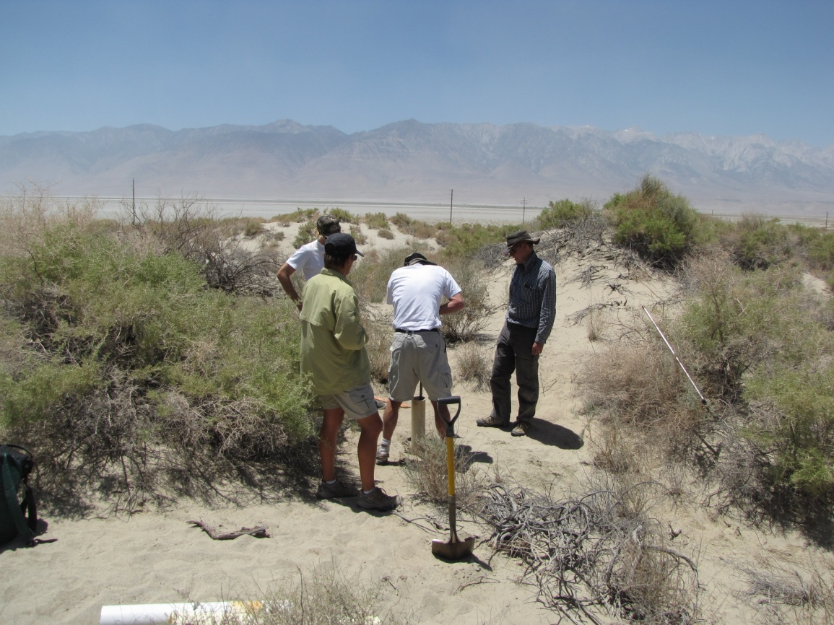
Prehistoric Dunes
Swansea dunes
Southeast dunes
Swansea dunes
Lizard Tail dunes
Lizard Tail dunes
Notes:
Photos of preserved Pre-historic dunes at Lizard Tail, Swansea and Southeast of Keeler
Dunes are vegetated with a mix of different desert shrubs (mostly = greasewood, atriplex, and sueada)
Dunes tend to form in linear bands parallel to lake shore associated with 1103 m shoreline (3619 ft elevation)

Slide 12
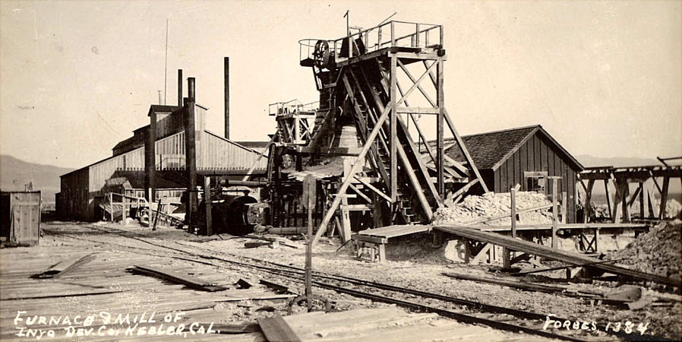
2. 1860 to 1920’s
Local Activities
Salt mining
Silver mining
Steam boats
Carson & Colorado and Southern Pacific Railroads
(No record of modern Keeler Dunes)
(trona mining on bed of Owens Lake south of Keeler c. 1912)
(Photos from the Eastern California Museum)
Notes:
Keeler area was the economic center of Inyo County in late 1800’s and early 1900’s
Keeler (Hawley) established in 1883. (population of ~7,500 people in late 1800’s) – (population in 2010 = 66)
Mining activities: silver mining at Cerro Gordo, salt mining from Owens Lake and Saline Valley, Talc mining in Cosos
Carson & Colorado railroad and Southern Pacific railroad (1883-1960)
Steamboats across Owens Lake (1870’s)
Tramways over the Inyo Mountains

Slide 13
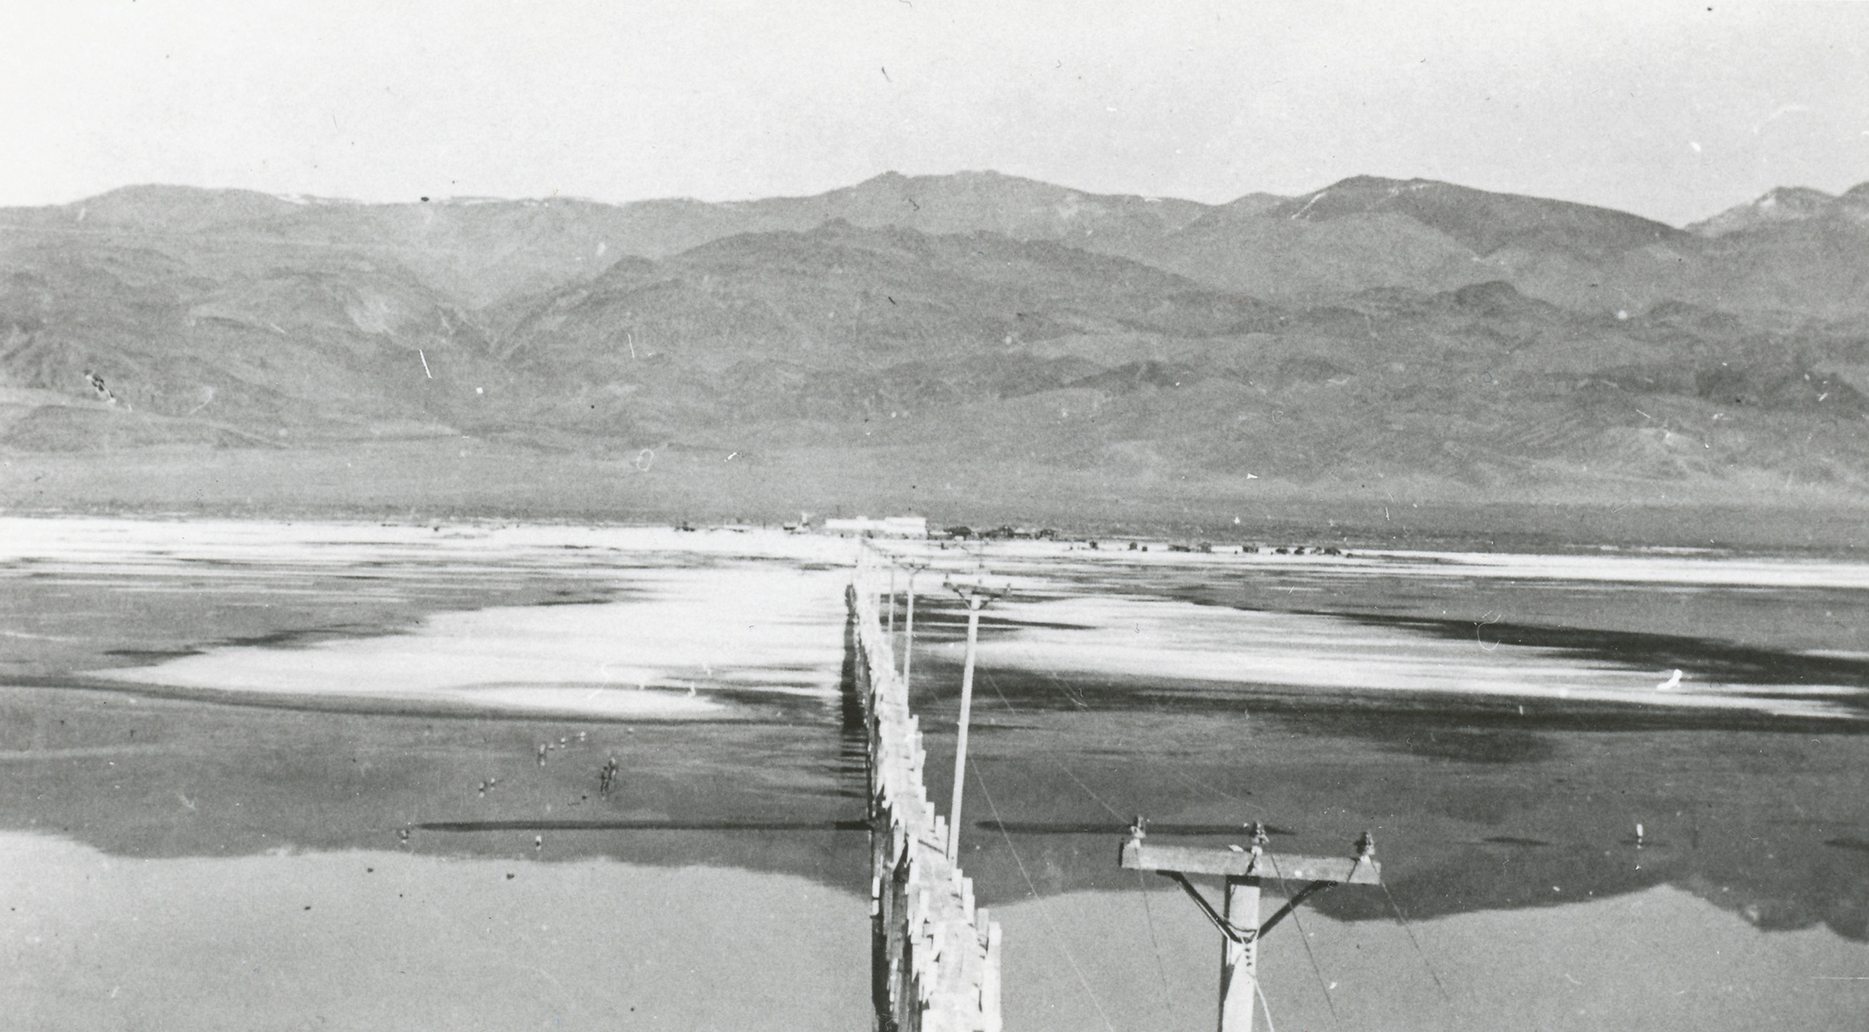
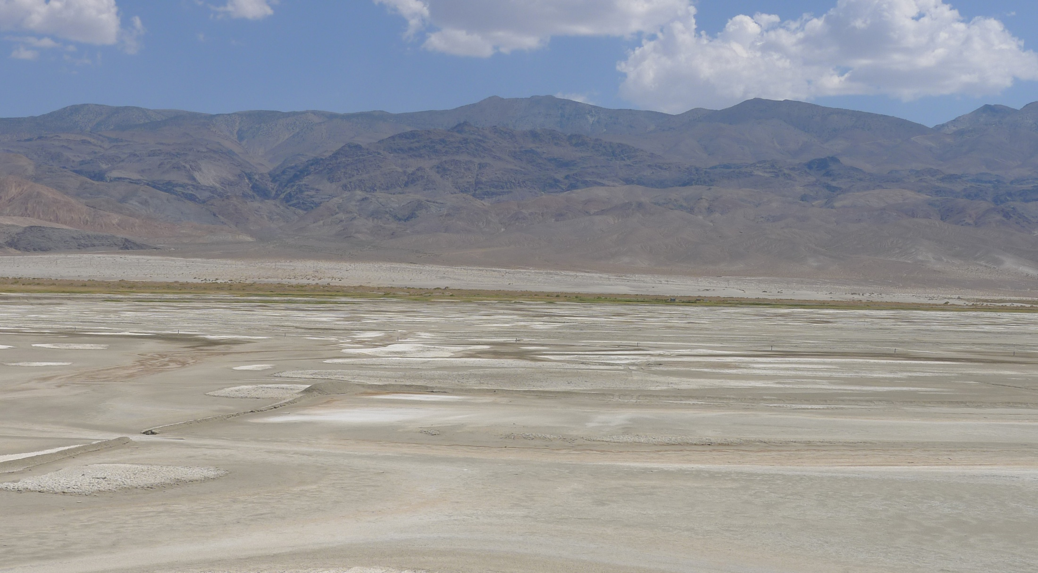
Inyo Development Company (IDC) c. 1920 vs 2012
Historic Photo Analysis
Active modern Keeler Dunes location
Keeler fan
Historic vegetated shoreline dunes
and saltgrass meadow
Lake bed/Playa surface
(c. 1920 photo from ECM)
(2012 photo by GBUAPCD, August 14, 2012)
Notes:
Re-Photo analysis of view from ~1920 to 2012
view to northeast from the lake bed looking across the lake bed towards the Inyo Mountains and the Keeler alluvial fan.
photo taken from ~10 foot tall concrete monument along an old wooden pipeline situated ~0.75 miles from the historic shoreline.
Historic photos taken circa 1920 right at the end of the Inyo Development Company operations (began operations in 1885)
IDC operated many solar evaporator ponds/panels that ran parallel to historic shoreline for crystallizing and mining trona to make soda ash.
Soda ash plant was located along the historic shoreline

Slide 14
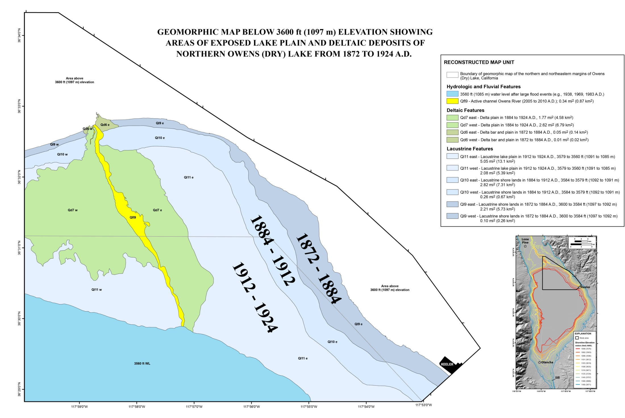
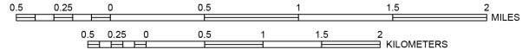
Exposed Lake Bed from Historic Desiccation
Total exposed area = 12.35 mi²
= 2.82 mi²
= 2.71 mi²
= 6.82 mi²
(Map by Bacon and Lancaster, 2012)
Notes:
Desiccation of Owens Lake – began in 1880’s with initial diversions of OR and creeks for agriculture
Based on Geomorphic mapping, three distinct bands of the lake bed and delta are evident and can be correlated to 3 time periods
1872-1884: 2.71 sq mi exposed (within the map area shown)
1884-1912: 2.82 sq mi exposed
1912-1924: 6.82 sq mi exposed
TOTAL AREA (east of river and within map area) EXPOSED DUE TO WATER DIVERSIONS = 12.35 sq mi

Slide 15
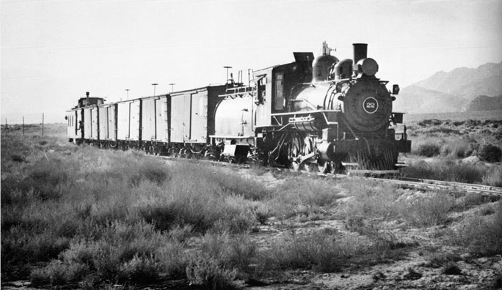
3. 1940’s-1960
Initial Development of the Modern Keeler Dunes
Sand encroachment onto Keeler Fan
Development of dune field in northwestern portion of Keeler Fan
Realignment of State Highway route
Twilight of Southern Pacific Railroad
(photo of train at north end of Keeler in 1940 by Frank J. Peterson (Ferrell, 1982))

Slide 16
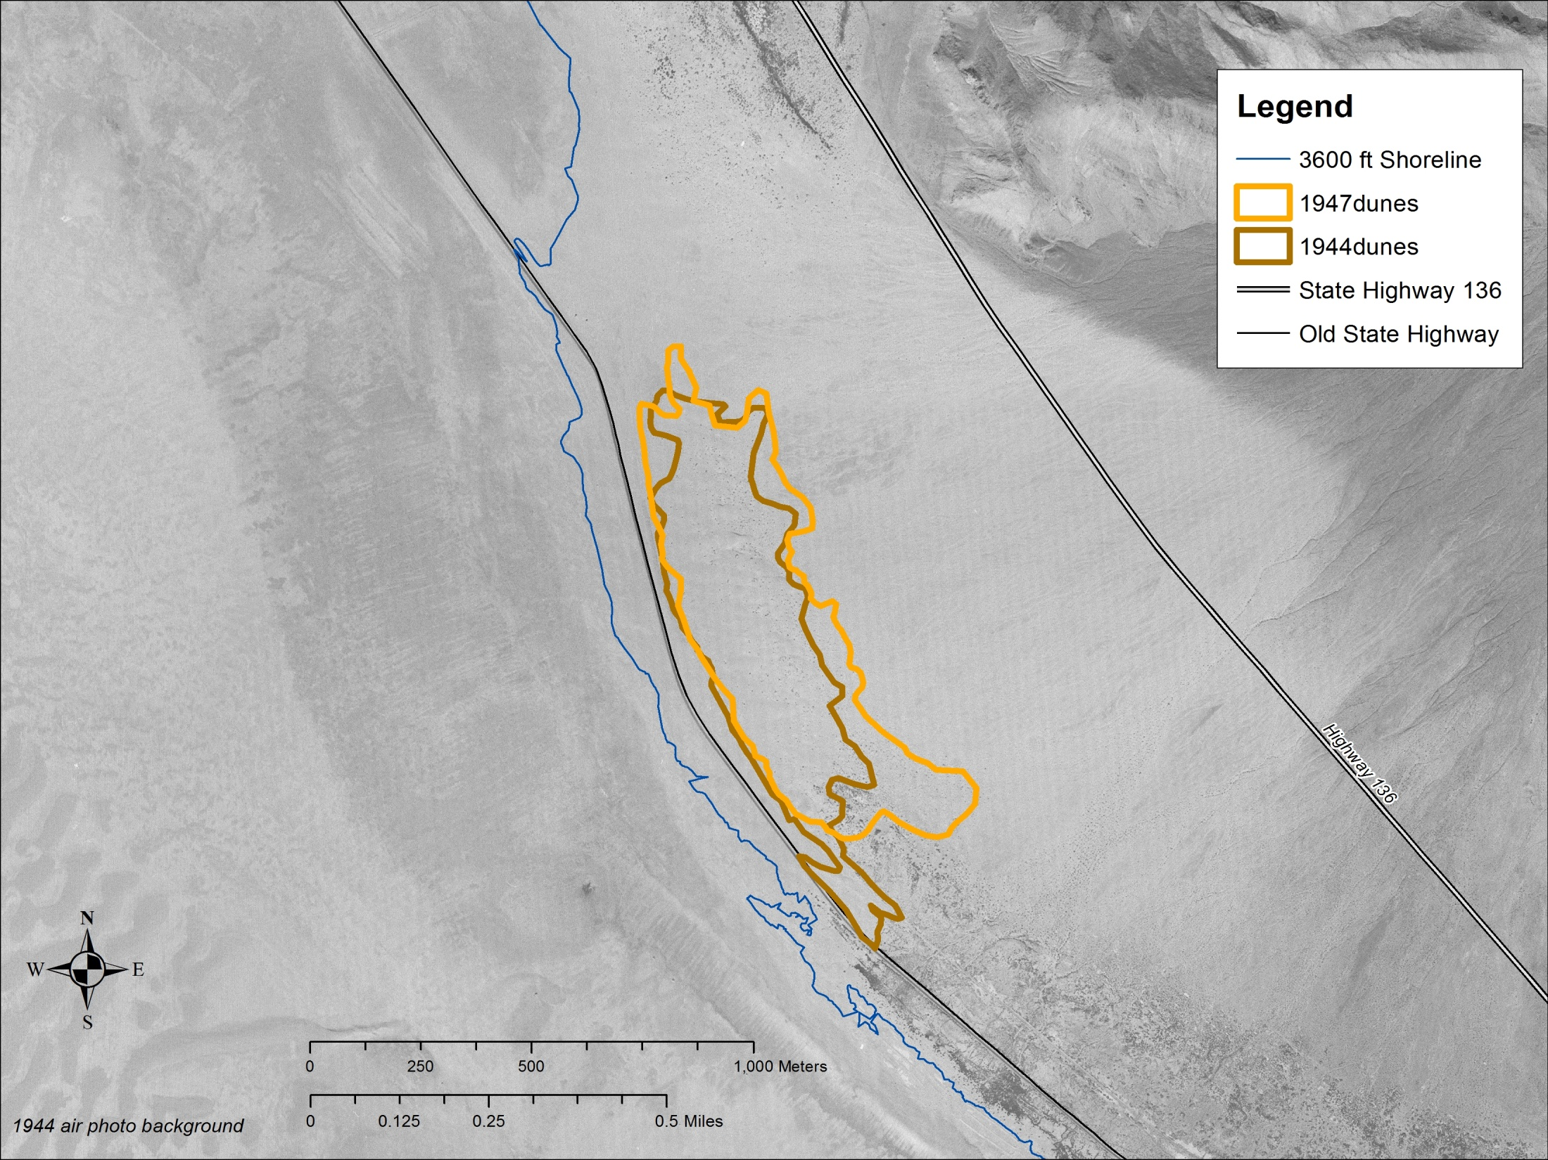
1944 and 1947 Dune Field Outline
Dune Field Area:
1944-1947 = ~ 70 acres
Sand Sheet Area:
~ 450 acres
1947
1944
Notes:
Map showing outline of dune field area in 1944 and 1947 – earliest air photos found during document and photo search.
1944 and 1947 dune area = ~70 acres, sand sheet area = ~450 acres (or about 6.5 times the size of the dunes)
Animation shows the approximate location of the Northwest prehistoric dunes in relation to dune field area of 1944 and 1947.

Slide 17
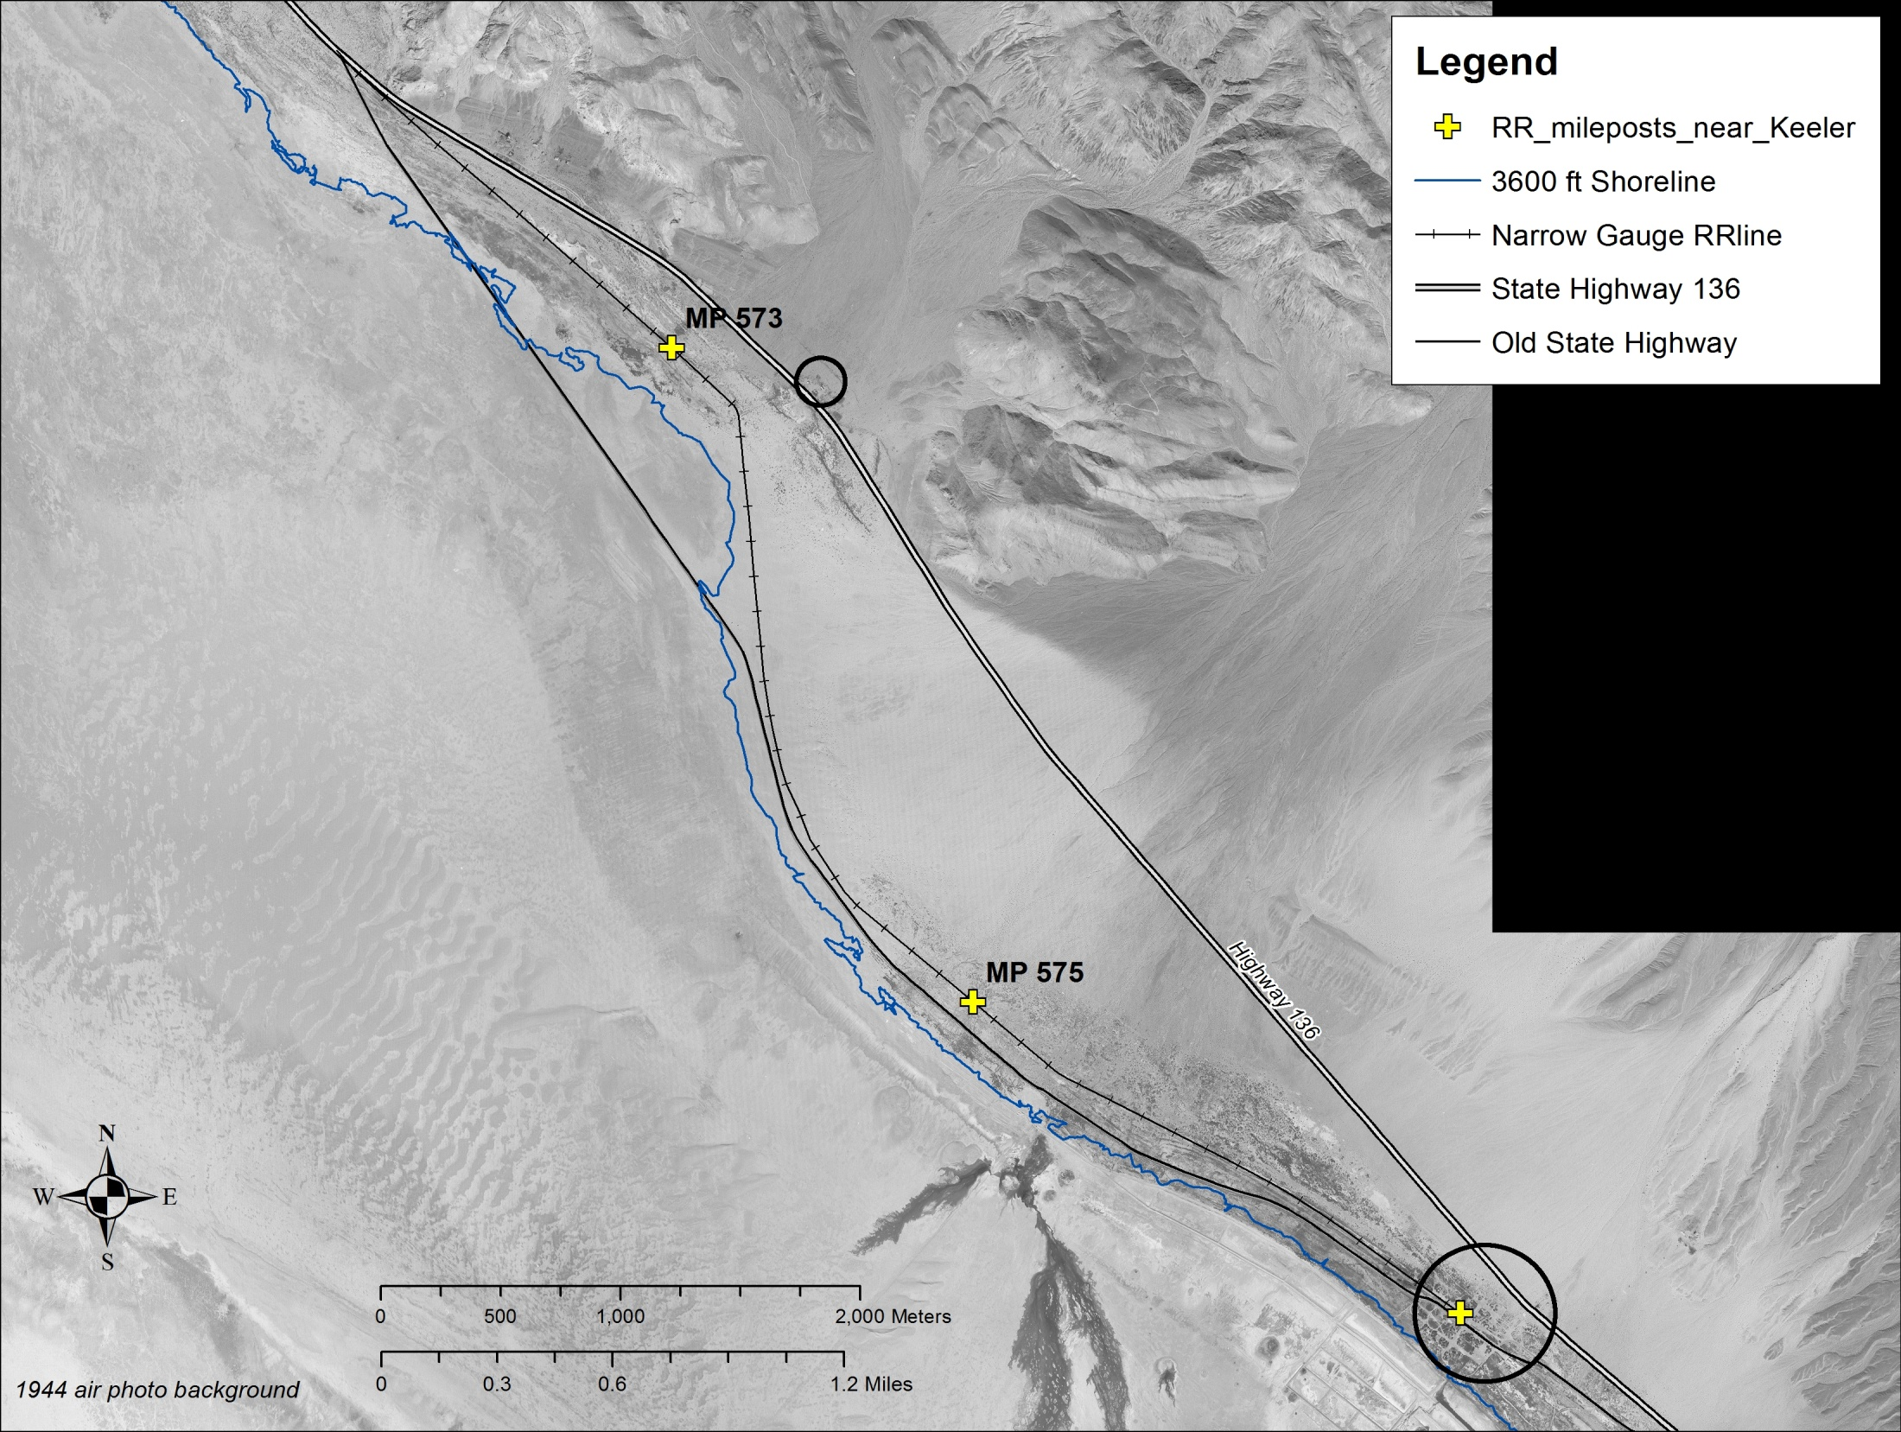
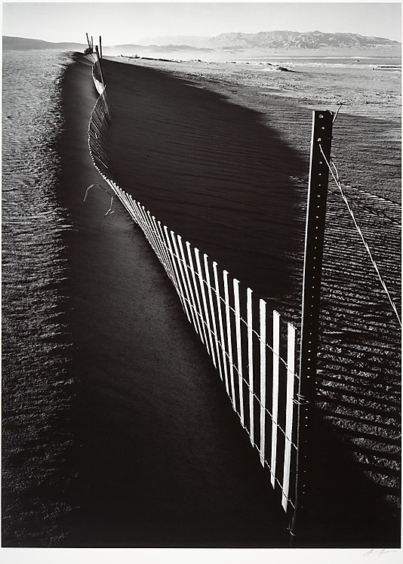
1950 Highway Realignment
Swansea
Old Highway Route
Train records indicate that in 1954 blowing sand was a problem from MP 573 to MP 575
1948 - Ansel Adams photos of sand fence
1953 photo of train
New Highway Route
Keeler
Notes:
Map showing the highway realignment in 1950. Highway moved from location near the historic shore of Owens Lake to present location across the mid portion of the Keeler Fan.
Highway was moved due to sand movement across road.
Yellow star: Ansel Adams photo from 1948 shows sand accumulation along one of the sand fences that was placed parallel to the old highway to capture loose and mobile sand.
Narrow gauge Southern Pacific railroad line shown with Mile Posts 573 and 575 – train records indicate that blowing sand was a problem along the track between these two locations in 1954. Train records in the 1930’s do not include sand drift warnings.
Orange star = location of historic photo view from 1953

Slide 18
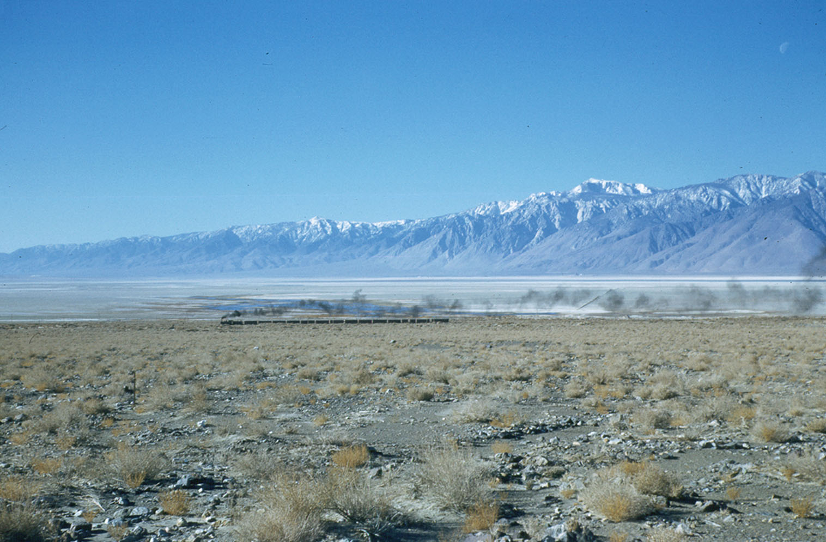
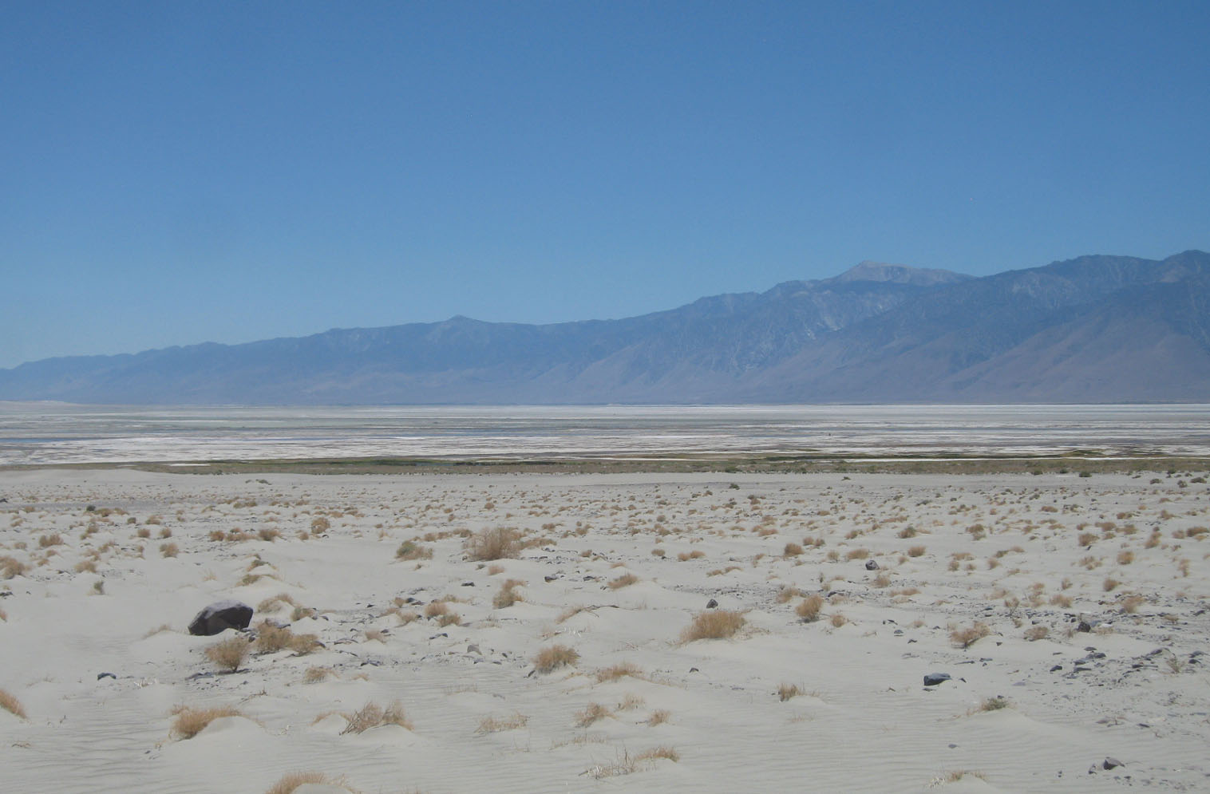
Train into Keeler, 1953 - 2012
Historic Photo Analysis
Vegetated dunes and saltgrass meadow
along historic shoreline
Northeast Pre-historic vegetated dunes
Active modern southern Keeler Dunes
Lake bed/Playa
Alluvial Fan
(photo from ECM: March 19, 1953)
Discontinuous sand sheet on top of alluvial fan
(photo by GBUAPCD July 3, 2012)
Notes:
Photo/Rephoto Analysis of view across southern portion of the Keeler Fan to the south looking across Owens Lake toward Cartago/Olancha from 1953 and 2012.
1953 photo taken during one of the last steam engine runs on the line. The diesel engine was being repaired and the steam engine was put into service.
(Ignore the train and focus on the landscape change.)

Slide 19
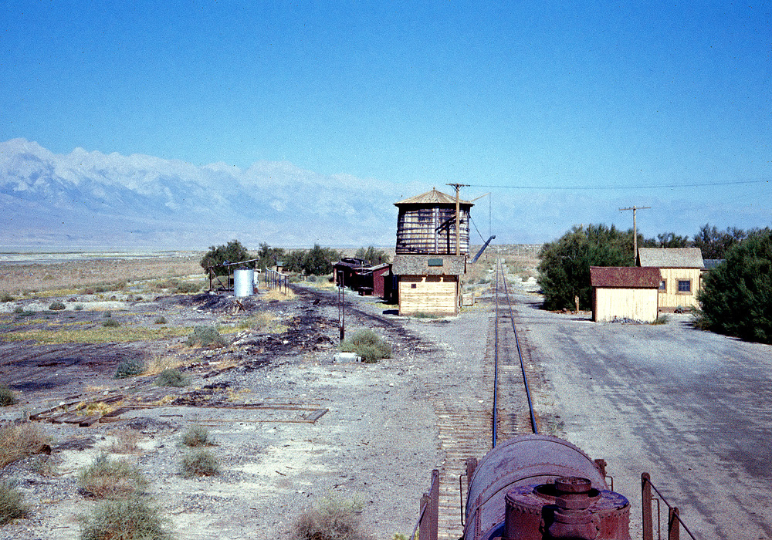
4. 1960-2000
Expansion and growth of the dune field and sand sheet
Development of southern Keeler Dunes
Southern Pacific Railroad ends in 1960
(view to northwest by John B. West of water tank and
railroad line at north end of Keeler, August 25,1959)

Slide 20
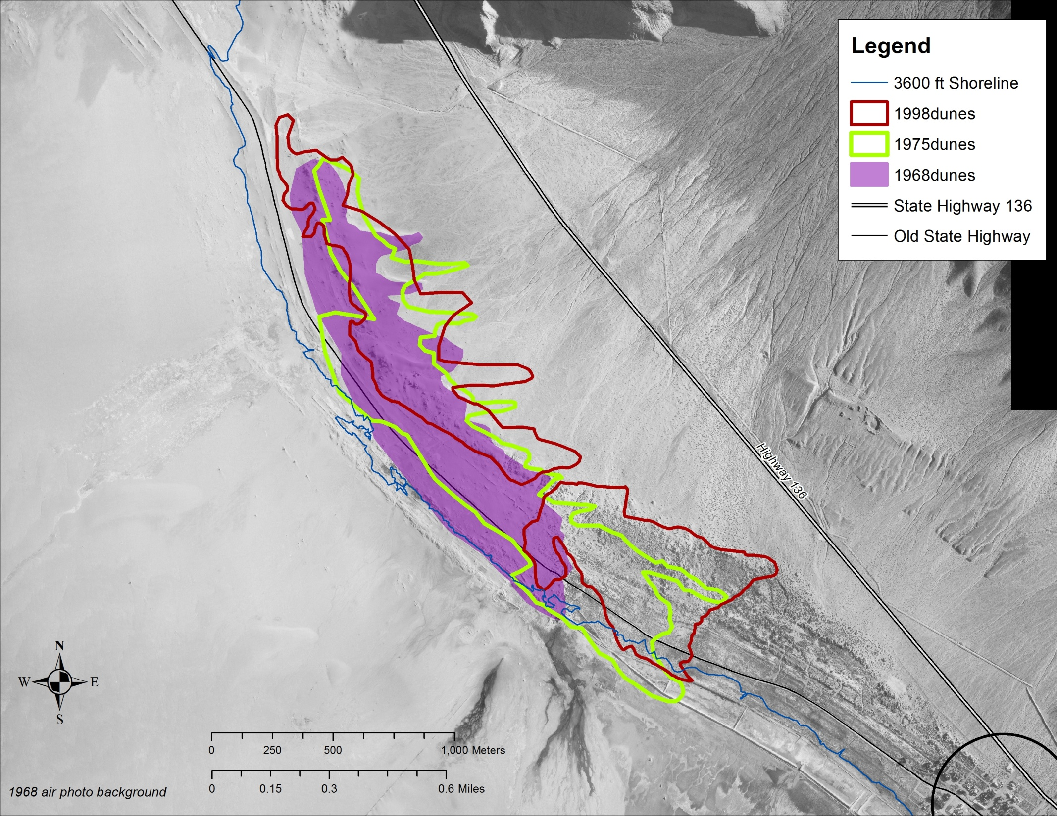
1968 to 1998 Dune Field Outline
Dune Field Area:
1947 = ~ 70 acres
1968 = ~ 167 acres
1998 = ~ 207 acres
Sand Sheet Area:
1947 = ~ 450 acres
1968 = ~ 1062 acres
1998 = ~ 992 acres
Keeler
Notes:
Map of Dune field area changes from 1968 to 1975 to 1998
Expansion of dunefield from 167 acres to 207 acres with growth to south and east
Sand sheet area change from 1062 to 992 acres
starting to get some erosion along western portion of deposit.

Slide 21
5. 2000 - 2013
Significant erosion of western and northwestern portions of modern Keeler Dunes sand deposit.
Dune erosion of ~100-200 meters (328 -656 feet) along northern and western portions of deposit.
Continued migration of southern edge of dunes toward Keeler at a rate of about ~100 feet per year.
Dust control implementation on Owens Lake bed.
(Oblique aerial photo by HydroBio with view to south across Keeler Dunes – September 2008)

Slide 22
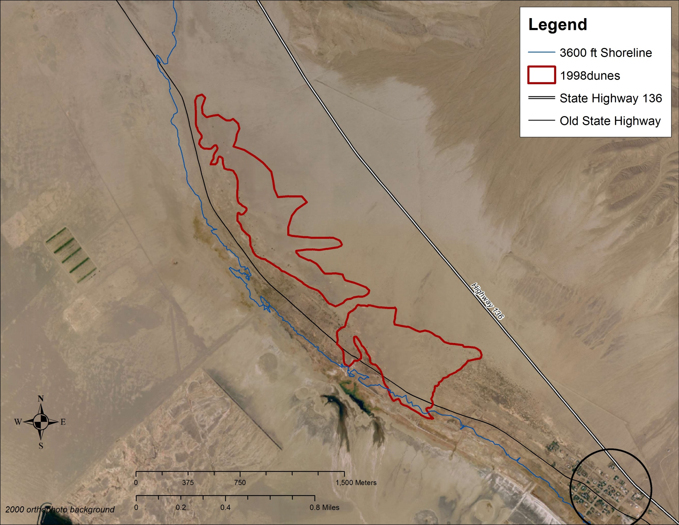
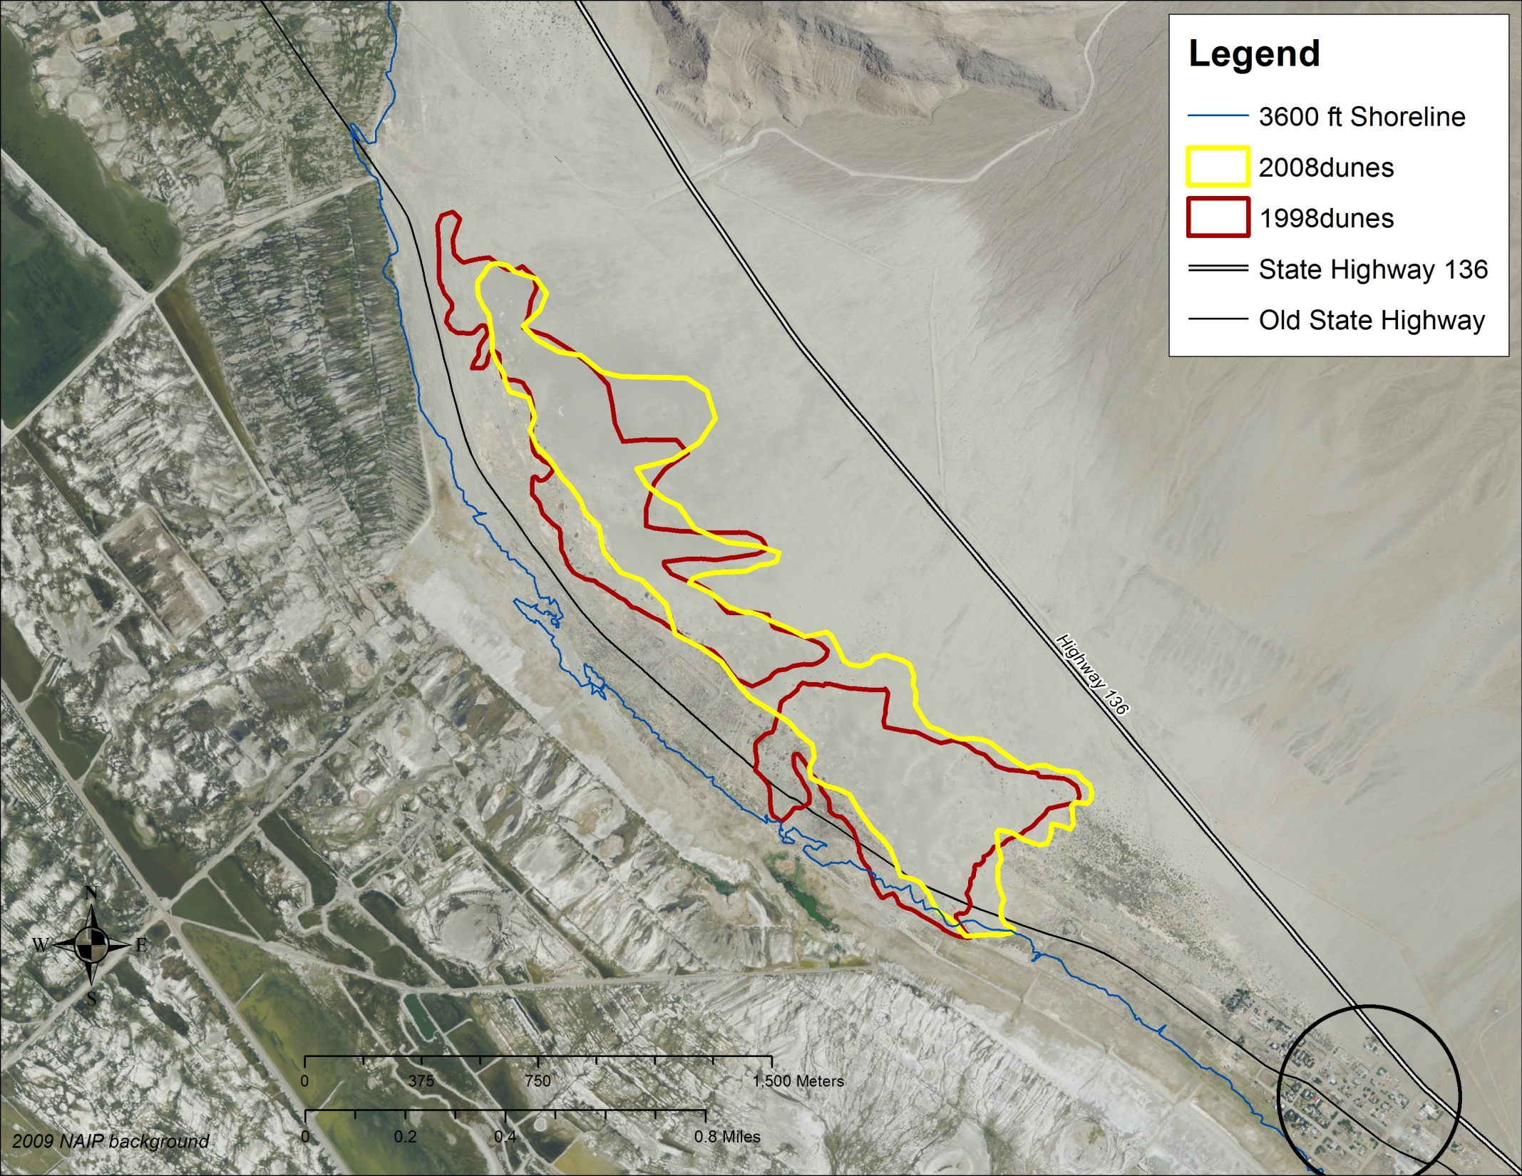
1998 to 2008 Dune Field Outline
Dune Field Area:
1998 = ~ 207 acres
2008 = ~ 192 acres
Sand Sheet Area:
1998 = ~ 992 acres
2008 = ~ 845 acres
Ansel Adams photo location
Erosion along western margin of dune field
Keeler
Notes:
Dust control implementation on lake bed started at the end of 2001 in the area adjacent to the Keeler Dunes.
Erosion distance = ~90-175 m on west and north
Dune field area decrease from 205 ac to 192 acres
Sand Sheet area decrease – 960 ac to 845 acres

Slide 23
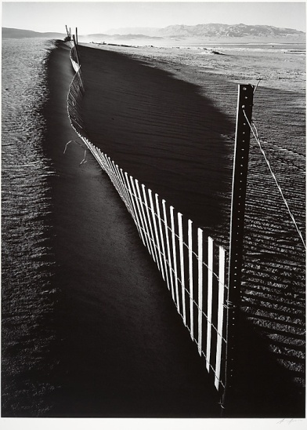
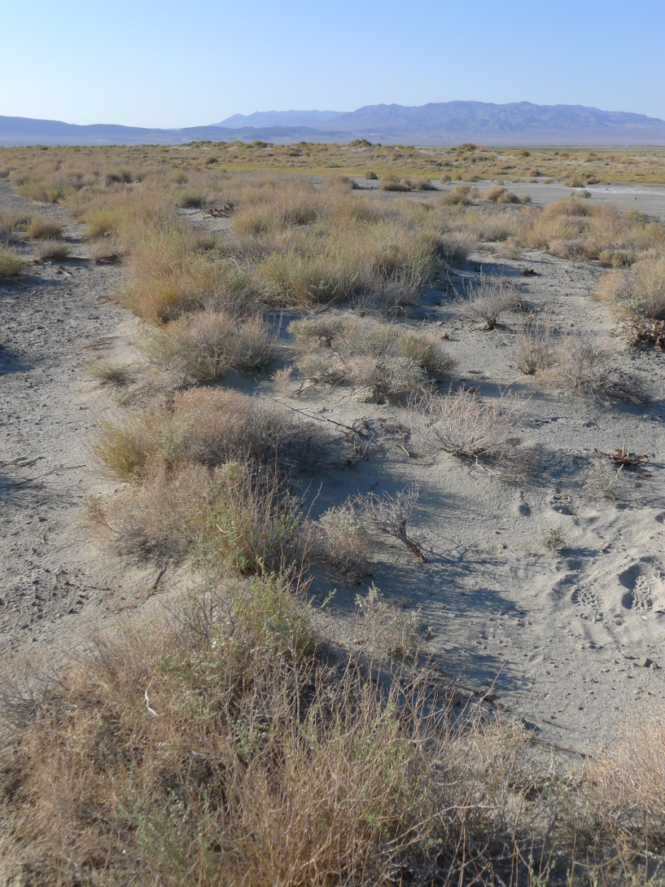
Erosion of sand along western edge of Keeler Dunes deposit
Establishment of vegetation
1948 Ansel Adams photo
2012 GBUAPCD photo
Notes:
Photo analysis of view from 1948 and 2012.
Ansel Adams photo from 1948 taken along one of the sand fences used to protect old highway from sand movement.
2012 view shows same location and that area has stabilized with the establishment of vegetation.

Slide 24
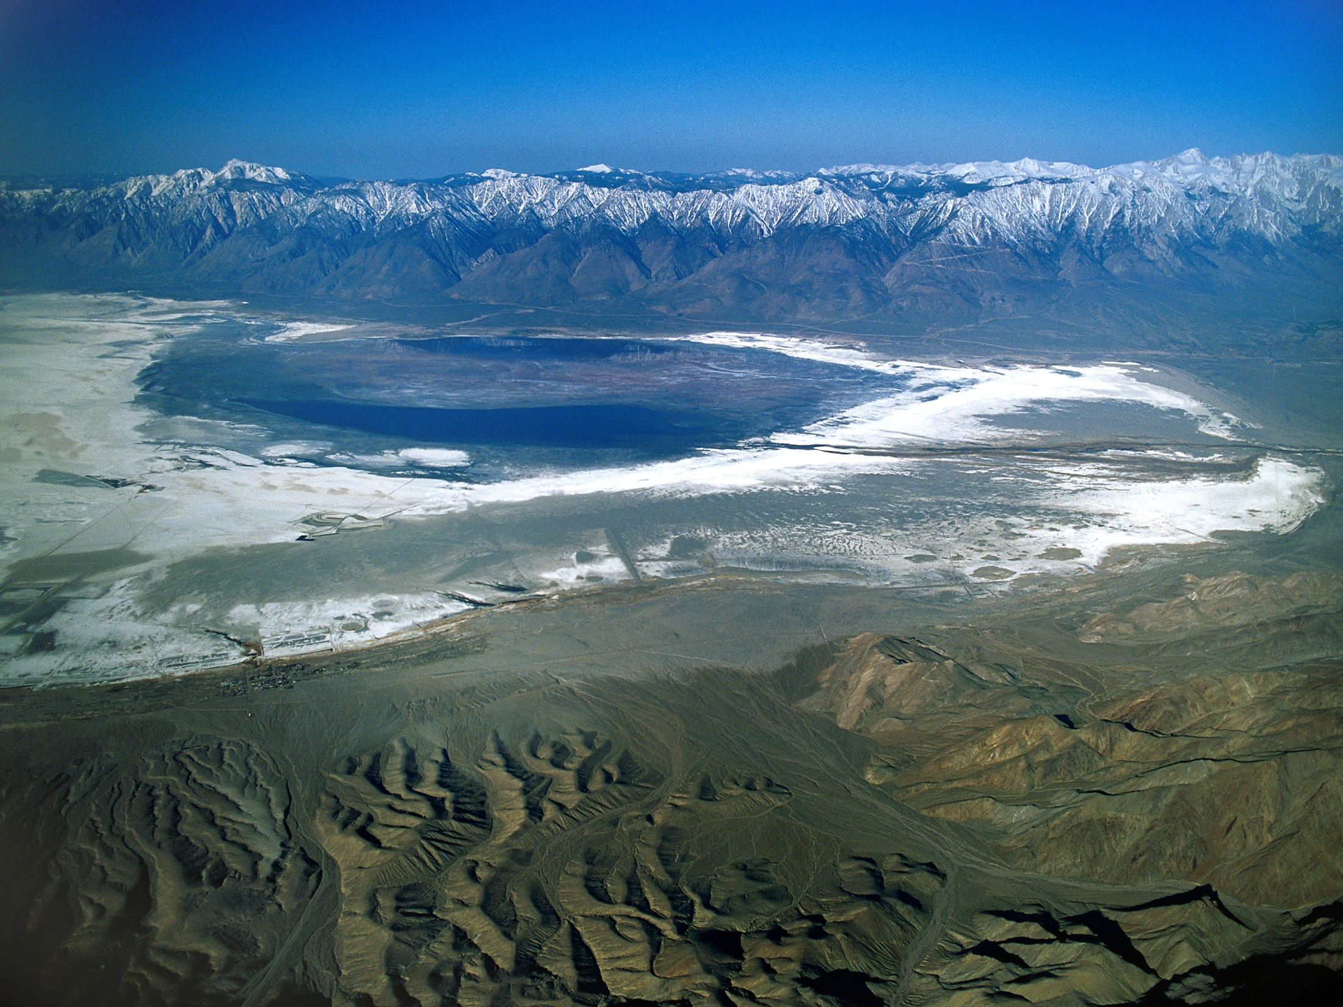

Analysis of Potential Sand Sources for the Keeler Dunes
Owens River/Delta
6. North Sand Sheet
2. Flood silts
4. 1872 Shoreline
Keeler Dunes
3. Swansea Dunes
5. Northwest Pre-historic dunes
1. Keeler Fan
Alluvium from Inyo Mtns
(Photo by Jim Wark, April 15, 1998)
Notes:
Sand Source analysis – 6 main sources evaluated
Alluvium from Inyo Mountains
Flood silt deposits on Keeler Fan
Erosion of Swansea and Lizard Tail dunes
1872 shoreline area
Erosion of northwest prehistoric dunes
erosion of lake bed exposed from desiccation of Owens Lake

Slide 25
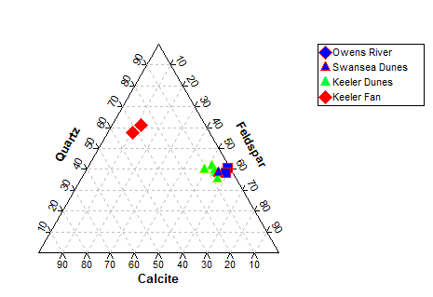
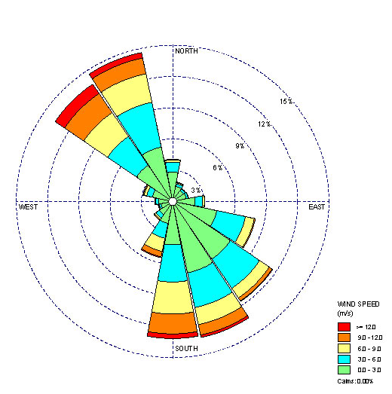
Important Considerations for Sand Source Identification
Area
Mineralogy
Volume
Particle size = sand
Transport direction
A-Tower Wind Rose
Volume

Slide 26
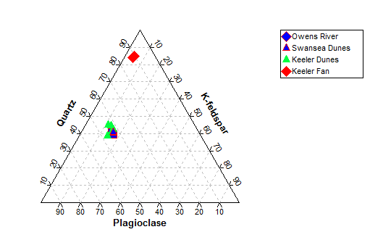
Mineralogical Analyses
Inyo Mountain Source
Owens River Source
Notes:
Point out the high calcite content and low feldspar content of alluvial fan samples
Sands from Owens River have low calcite and high feldspar

Slide 27
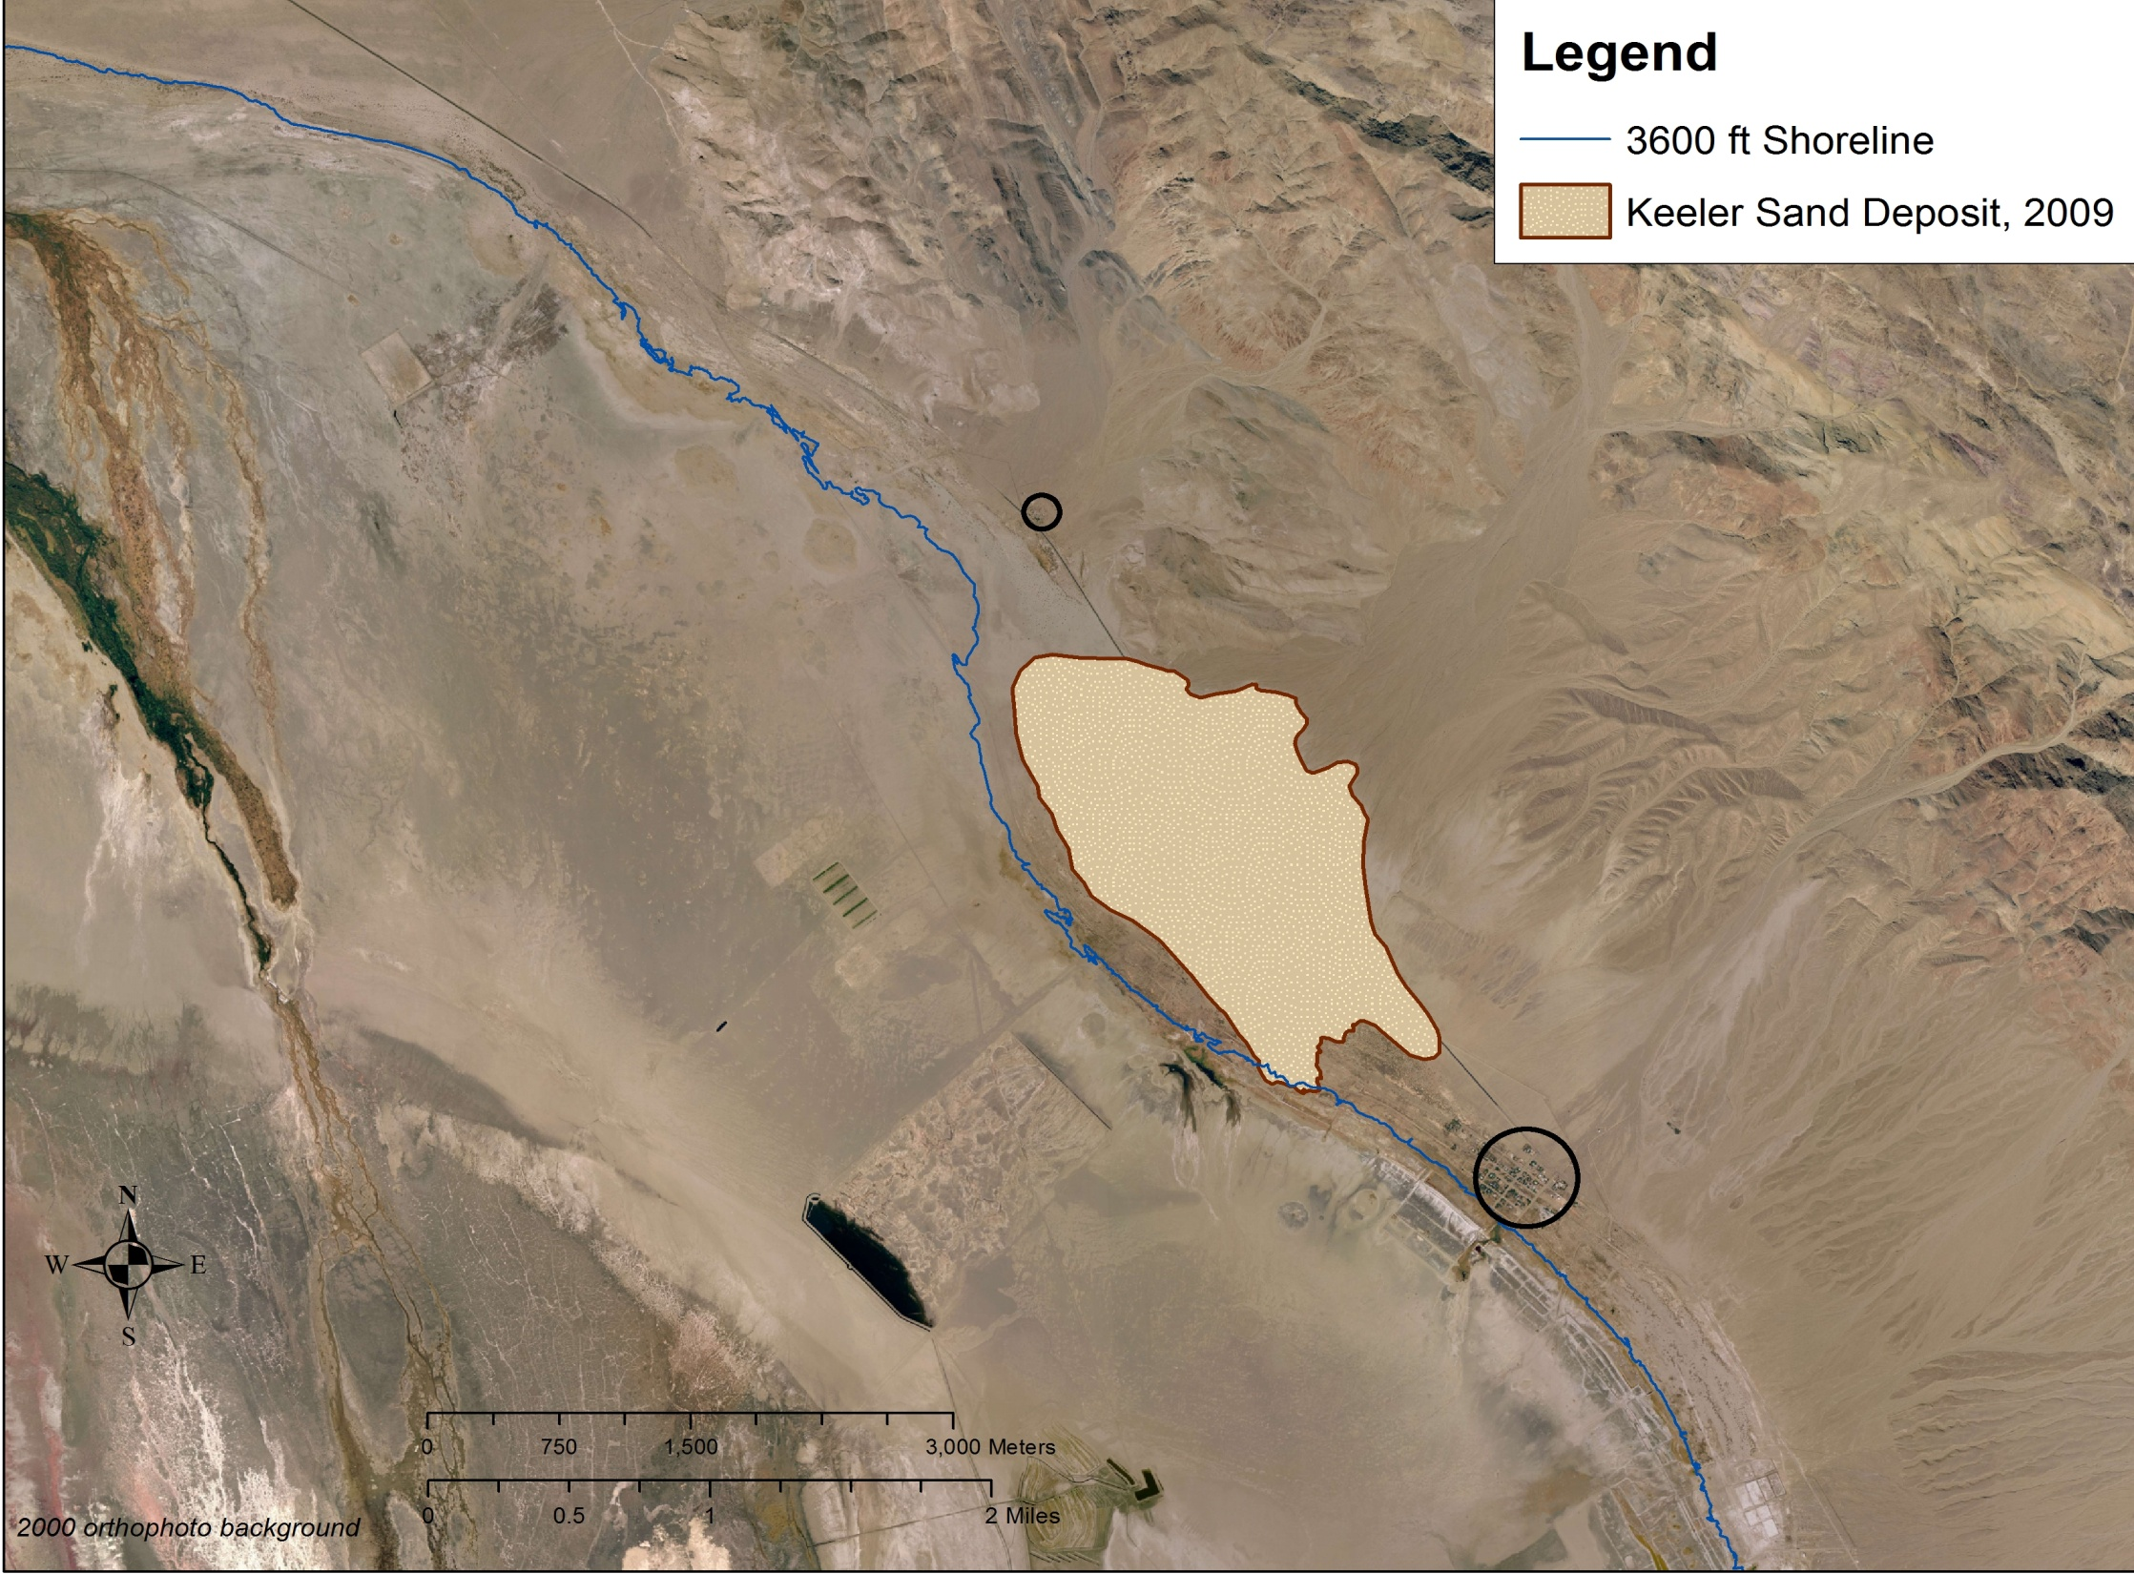
Sand Source Summary
3. Lizard Tail Dunes
4. 1872 Shoreline
Alluvium from Inyo Mountains
6. Owens Lake Bed
3. Swansea Dunes
Modern
KEELER DUNES
and
SAND SHEET
2. Flood Silts
5. Northeast
Pre-Historic dunes

Slide 28
Sand Source Summary
?
(Estimate including sand sheet areas)
?

Slide 29
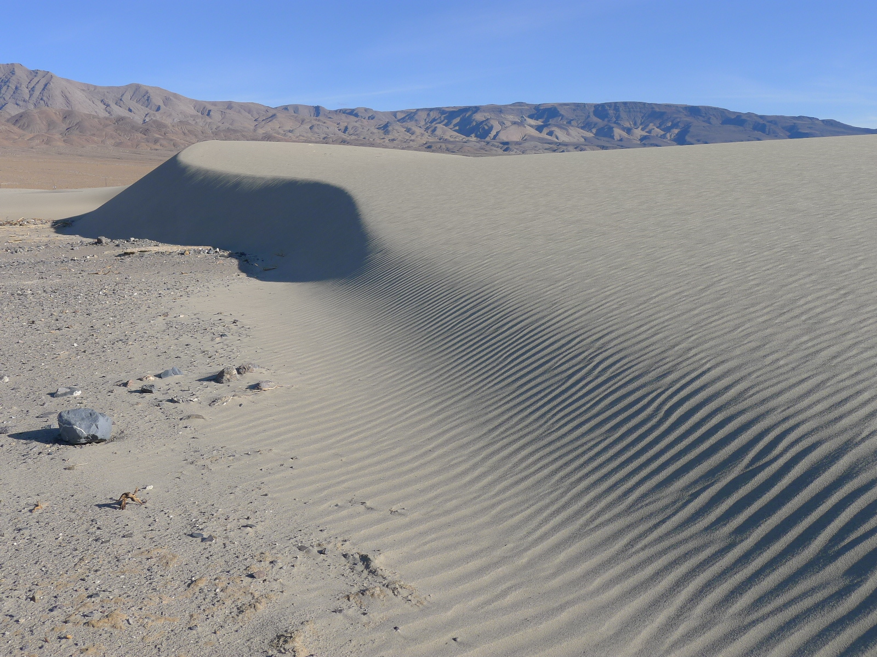
May 2013 - Continued Public Hearing
Staff Recommendation:
Purpose of the hearing is to have the Governing Board make a determination on the Origin and Development of the Keeler Dunes.
ALL materials must be submitted at least 4 weeks in advance of hearing and made available to the Board and all interested parties.
Late materials, by any party, will not be accepted into the record for consideration.
District staff will prepare a Board report that will be included in the Board Packet and made available to all parties prior to the hearing.
At the continued hearing District staff will make a presentation to the Board summarizing the materials received. This will be followed by public comments and discussion by the Board.
(GBUAPCD photo of one of the southern Keeler Dunes December 3, 2012)

